Slide 1
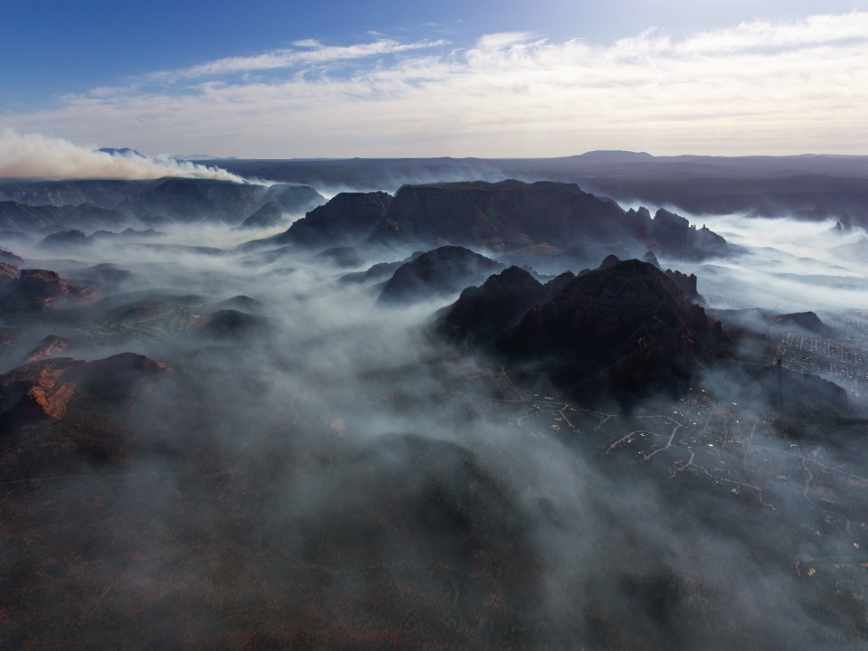

Smoke Tools and Information for Prescribed Fire and Wildfire
Types of Smoke Models (Theory)
Fire Emissions Calculation
Smoke Forecasting Systems
Smoke Tools
Satellite Information for Smoke and Fire
Putting on Your Smoke Glasses
Prescribed Burning in the WUI of Bend, Oregon
Photo – Ted Grussing

Slide 2
Fire Location Information
+
+
Weather Observations
Weather Model Output
Fire Emissions Model
Simple Approximation Systems
Trajectory Model
Dispersion Model
Smoke Plume
Location Approx.
Smoke Concentration Maps
model complexity

Slide 3
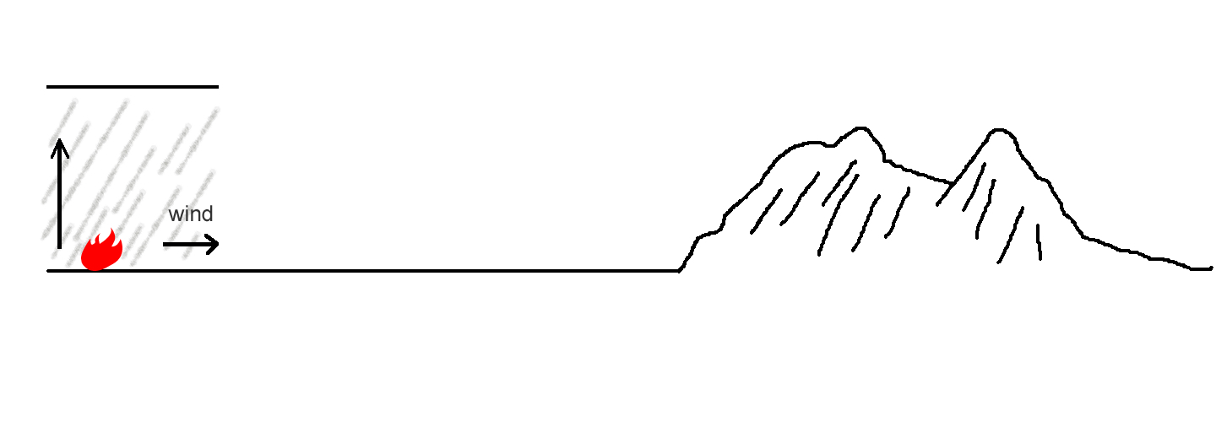

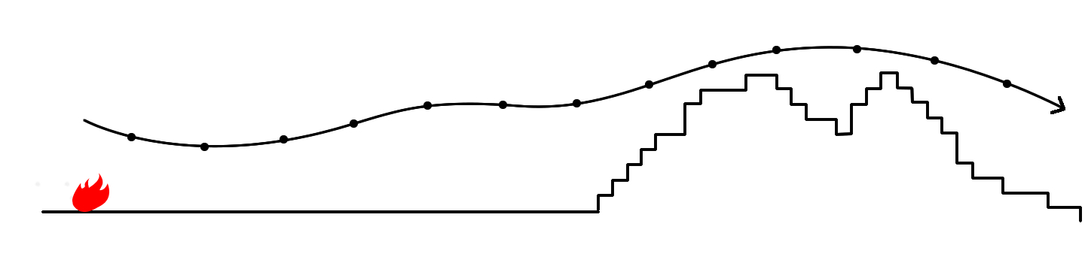
Types of Modeling
Examples:
Wind direction screening
Ventilation index
VSMOKE
HYSPLIT (trajectories)
FLEXTRA
Simple
Plume
Trajectory
From Larkin et al. Smoke Prediction Tools

Slide 4
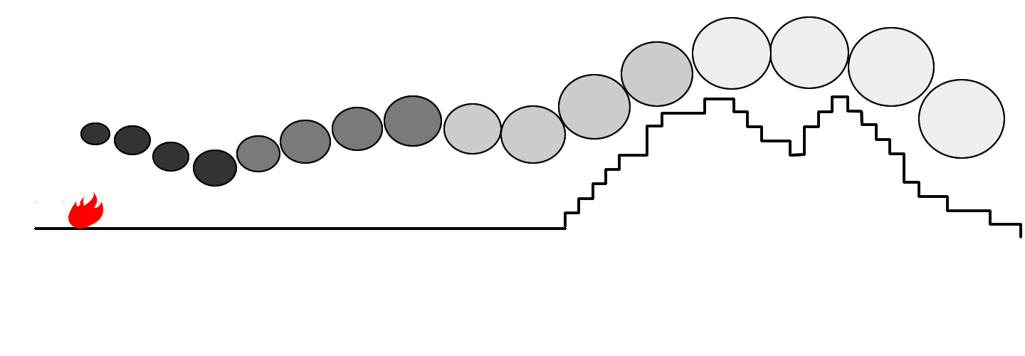
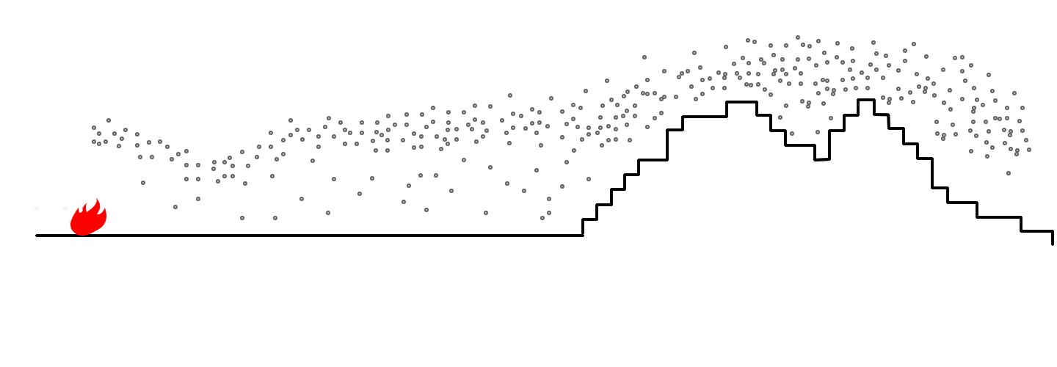
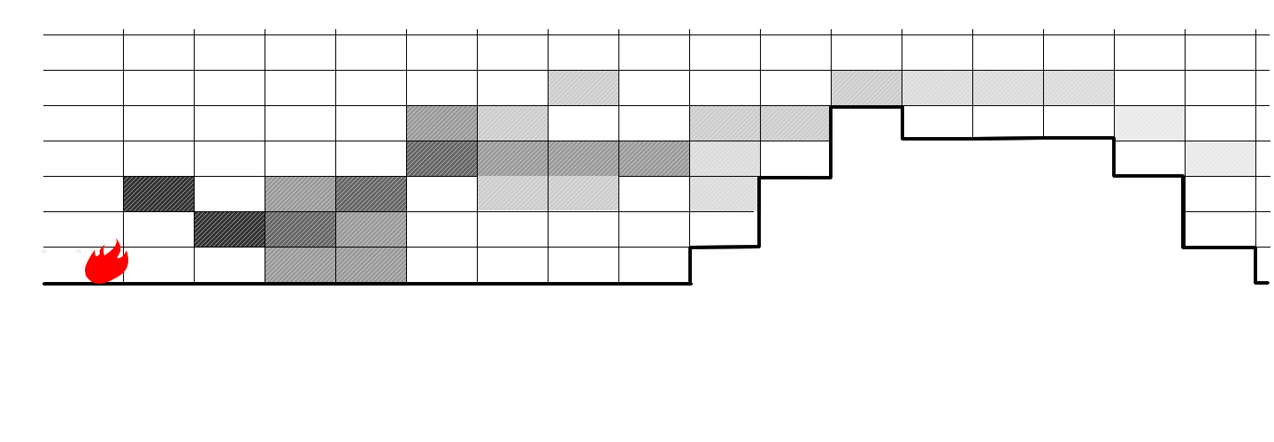
Types of Modeling
Examples:
CALPUFF
HYSPLIT (in puff mode)
SCIPUFF
HYSPLIT (in particle mode)
FLEXPART
CMAQ
WRF-CHEM
WRF-CMAQ
GEOS-CHEM
GEMMAQ
Puff
Particle
One-atm
One-atmosphere
From Larkin et al. Smoke Prediction Tools

Slide 5
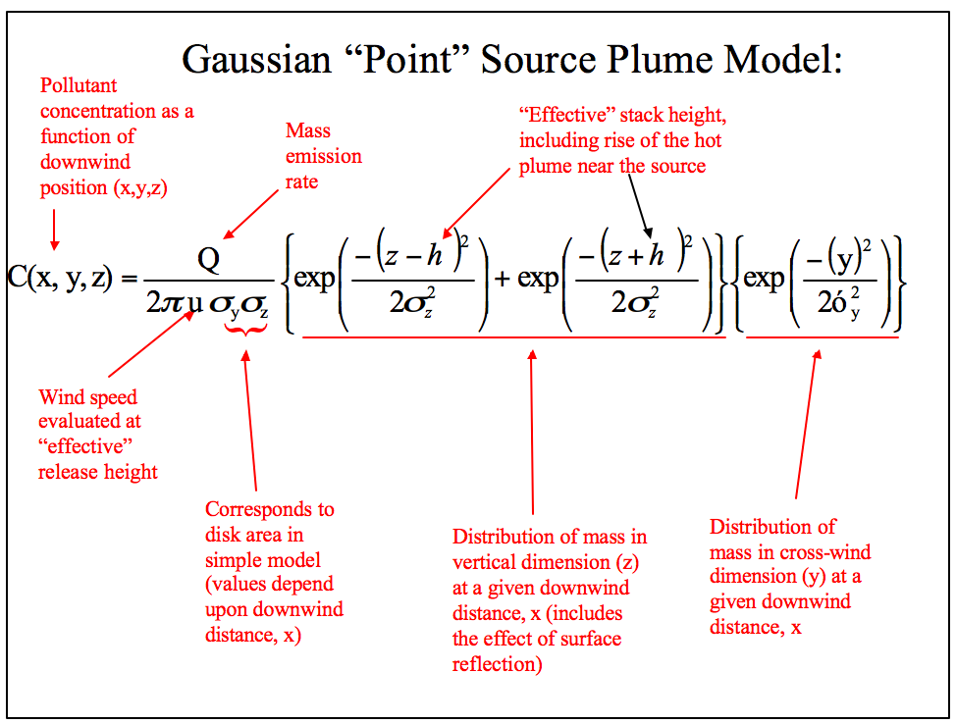

Slide 6
BlueSky Smoke Modeling Framework
Components to Calculating Fire Emissions
Fire
Info
Meteorology
SMARTFIRE2
NOAA HMS
GEOMAC
IRWIN
Rx Sys
Manual
Other
WRF
MM5
NARR
Station data
Fuels
FCCS
FCCS-LF
NFDRS
Hardy
GVDS
LANDFIRE
Ag
Other
Total Consumption
CONSUME
FOFEM
FEPS
FLAMBE
FINN
Other
Time
Rate
Rx / WF
FEPS
FOFEM
EPM
WRAP
Other
Emissions
FEPS
Literature
EPM
FOFEM
FLAMBE
FINN
Other
Plume
Rise
Large uncertainties exist with each modeling step
Briggs
FRP
Other
Smoke Modeling
HYSPLIT,
CMAQ, VSMOKE
GEM-MACH

Slide 7
Fire
Info
Meteorology
Fuels
Total Consumption
Time
Rate
Emissions
Plume
Rise
Large uncertainties exist with each modeling step
Smoke Modeling

Slide 8
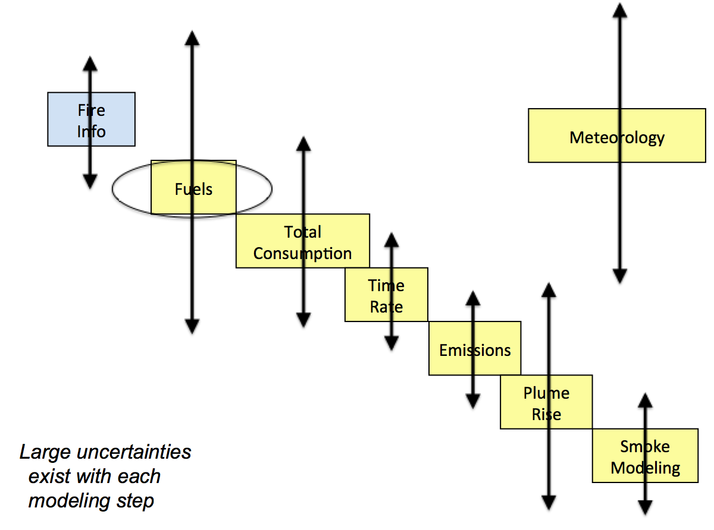
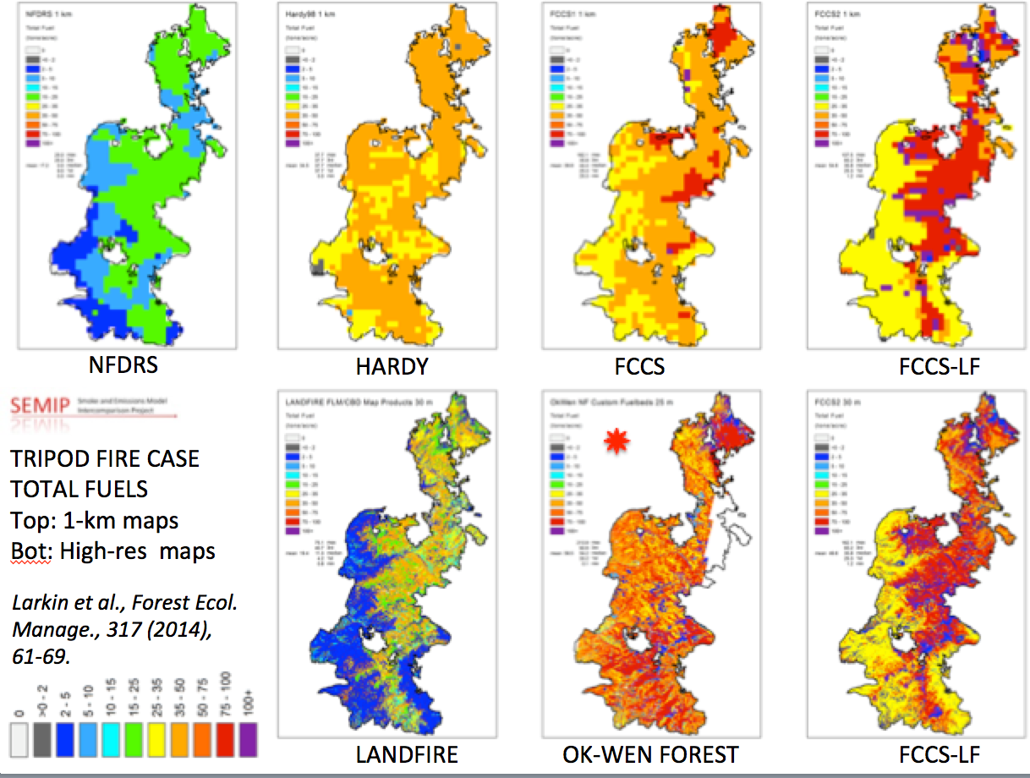
Fuels Variability
Order of Magnitude
From:
2-10 tons/acre
to
> 100 tons/acre

Slide 9
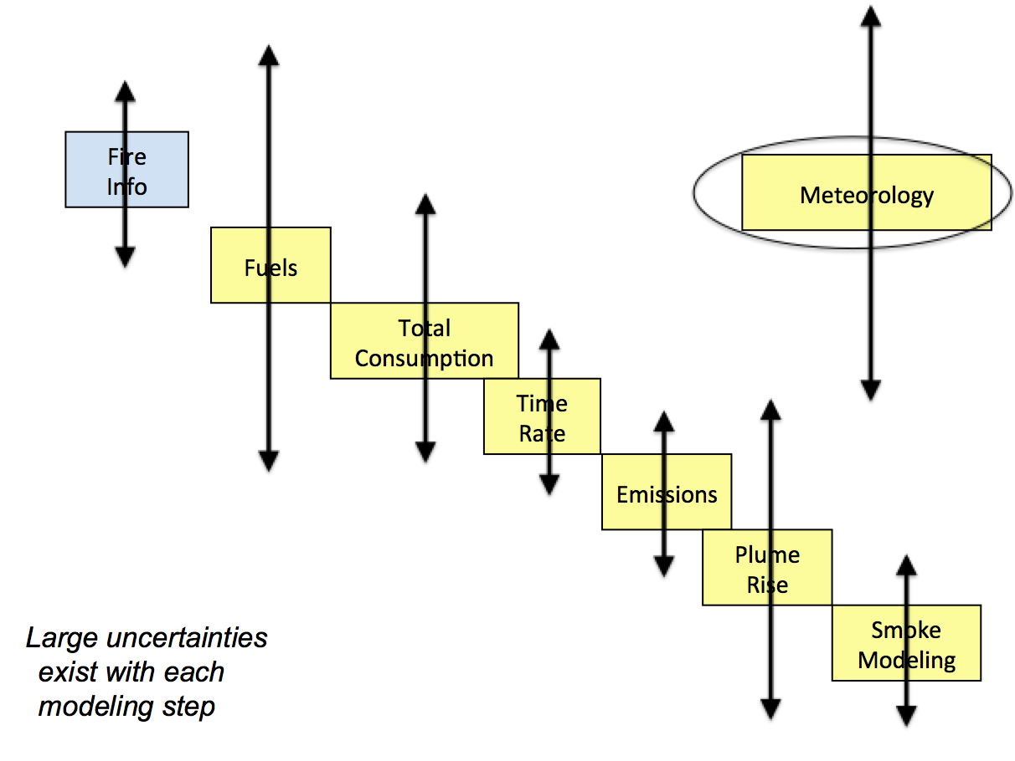
Meteorological Uncertainty
Wind Direction Mean Error
Day:
40 deg
Night:
80 deg

Slide 10
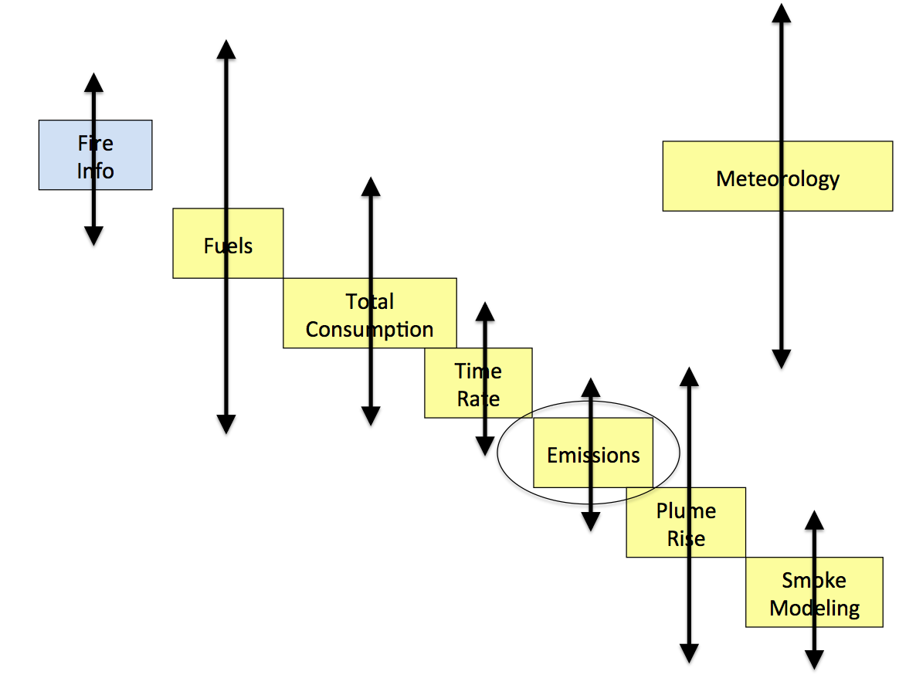
PM2.5 Emission Factors
Urbanski 2014
New Analysis
Emission Factor (EF): mass pollutant released per mass fuel consumed (e.g. g/kg)
Factor of 2 Variability
FEPS
CONSUME

Slide 11
Reality
Reality
Fire
Info
Fire
Info
Fuels
Fuels
Total Consumption
Total Consumption
Time
Rate
Time
Rate
Emissions
Emissions
Plume
Rise
Plume
Rise
Dispersion /
Trajectories
Dispersion /
Trajectories
right answer, wrong reasons
right answer, right reasons

Slide 12
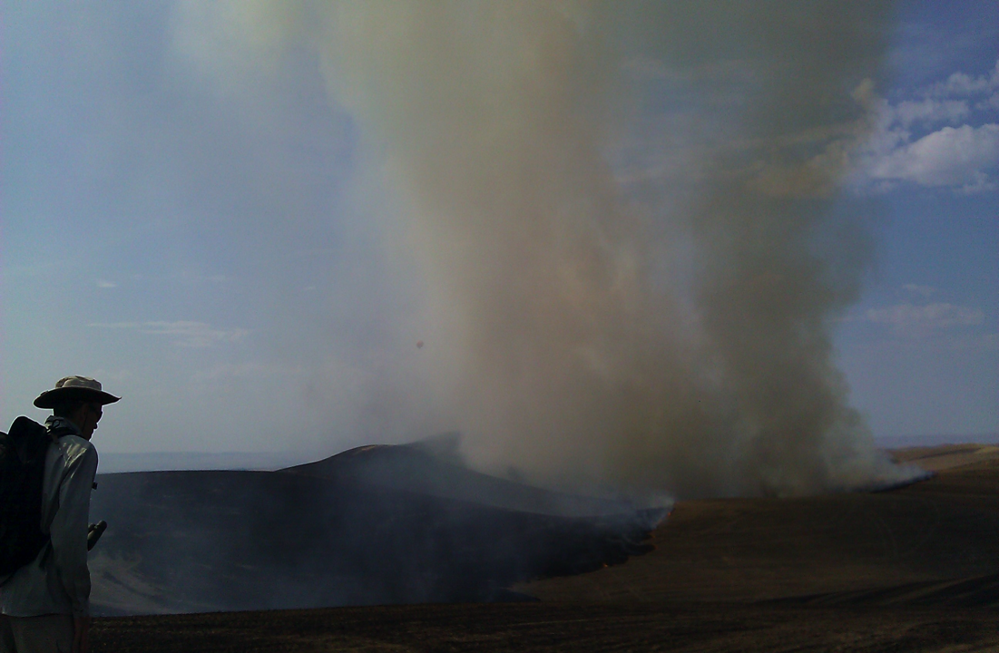
Smoke Model Online Resources (Forecast Systems)
BlueSky Daily Operational Runs
http://www.airfire.org/data/bluesky-daily/
NOAA Air Quality
http://www.nws.noaa.gov/airquality/ww.shtml
High Resolution Rapid Refresh (HRRR) – Smoke
https://rapidrefresh.noaa.gov/hrrr/HRRRsmoke/
Canada – Firework
https://weather.gc.ca/firework/index_e.html
Canada – BlueSky
http://firesmoke.ca/
Northwest US – AIRPACT
http://lar.wsu.edu/airpact/
Southeast US – HiRes2
https://forecast.ce.gatech.edu/
“Picking a model of choice for the day is a little like speed-dating: too little time/information to make up the mind leading to regrets by the end of the date/shift.”
- Wes Adkins, Meteorologist, National Weather Service, Juneau, AK
Notes:
Links in Lesson Plan

Slide 13
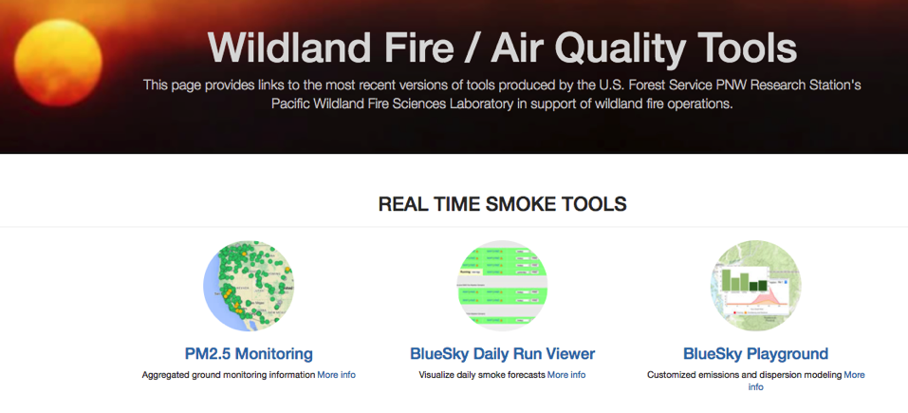
Tools for Wildfire and Rx Fire Smoke https://tools.airfire.org/

Slide 14
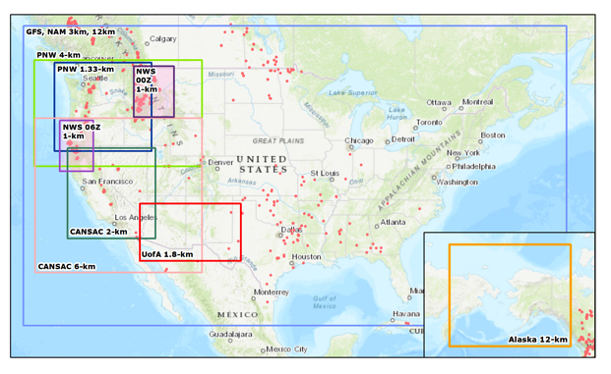
Tailored Smoke Predictions Delivered to Incident Management Teams
Domains
  2-km CA/NV
  6-km Western US
  1.33-km WA/ID
  4-km PNW
  12-km CONUS
  12-km Alaska
  3-km CONUS
  1.8-km AZ/NM
  1-km FW (moveable)
Partnerships: NWS, UW, DRI, UofA
HYSPLIT – Primary near-surface 1-hr PM2.5
Notes:
Partnerships!

Slide 15
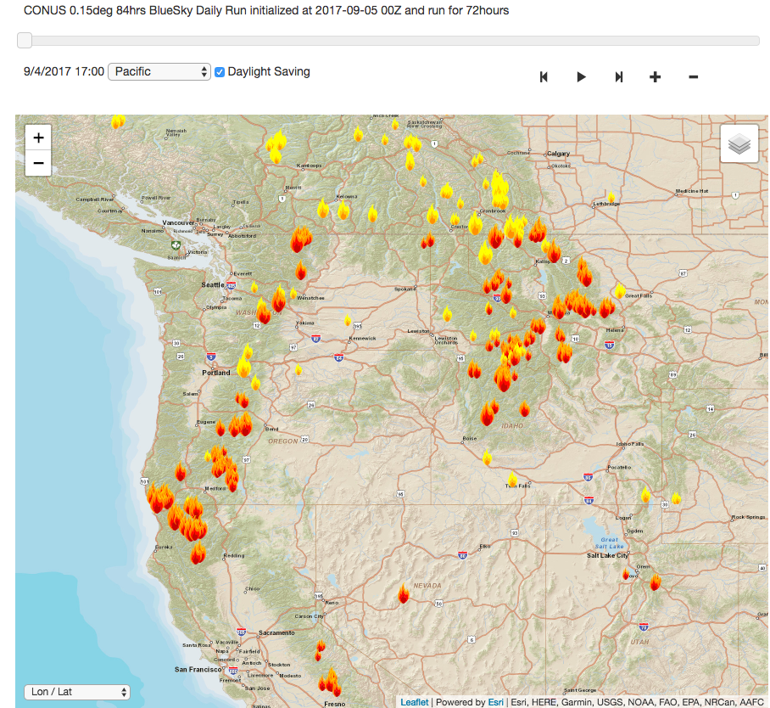
Tailored Smoke Predictions Delivered to Incident Management Teams
Fire Activity Information
NOAA Hazard Mapping System (HMS) Satellite Fire Detections
SmartFire v2 (SF2) augments (fire type, fire size, aggregation)
Notes:
Partnerships!

Slide 16
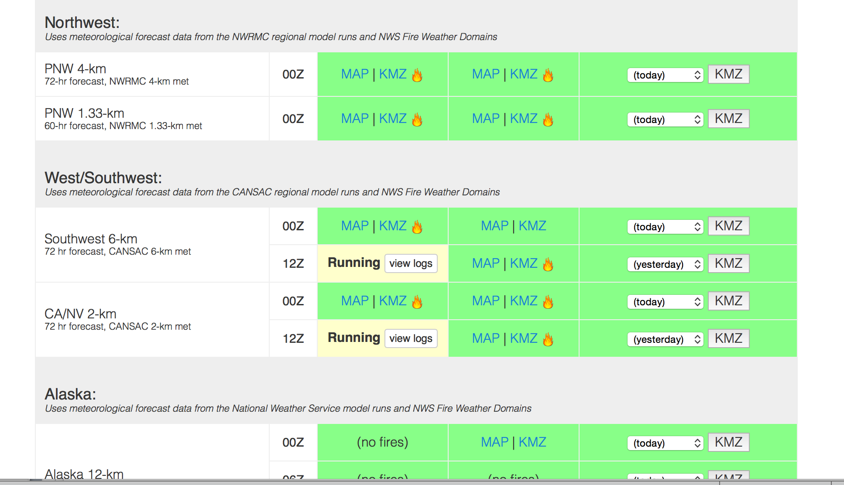

http://www.airfire.org/data/bluesky-daily/
Number of Fires
Running (click on “view logs” for run progress)
Successful!
Failures show up in red.
Website shows status of current runs
Notes:
12 domains per day, 6 are run twice a day (00Z, 12Z) – 18 hysplit particle runs. Many puff runs too.
This does not include custom runs.

Slide 17
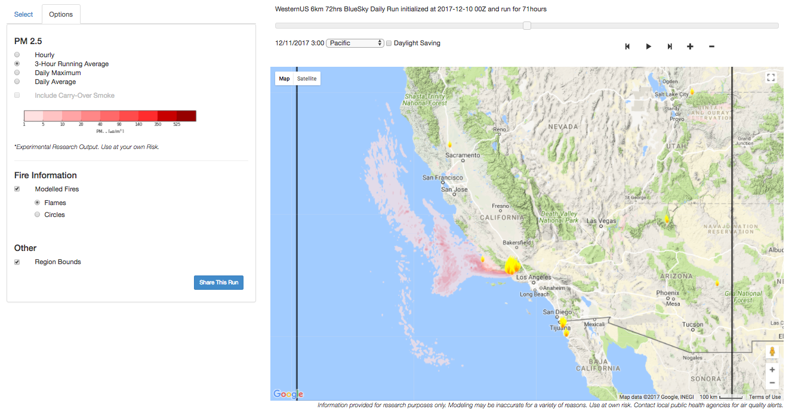
Daily BlueSky Production Runs
12/10/2017 Satellite Fire Detections & PM2.5, 6-km http://www.airfire.org/data/bluesky-daily/

Slide 18
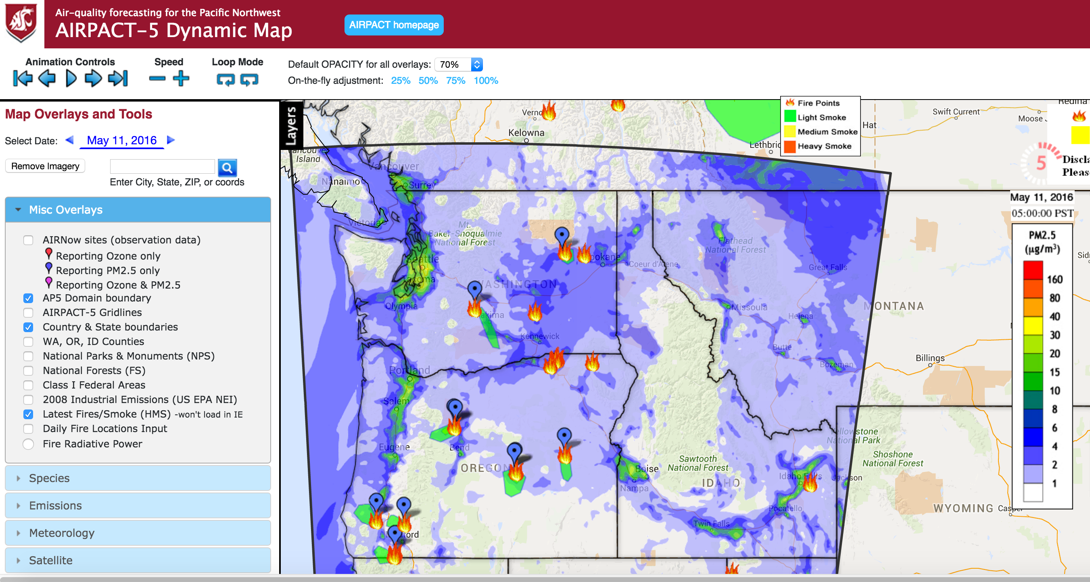
AIRPACT – Northwest
CMAQ
4-km
72-hours
Ozone, PM2.5
BlueSky Fire Emissions

Slide 19
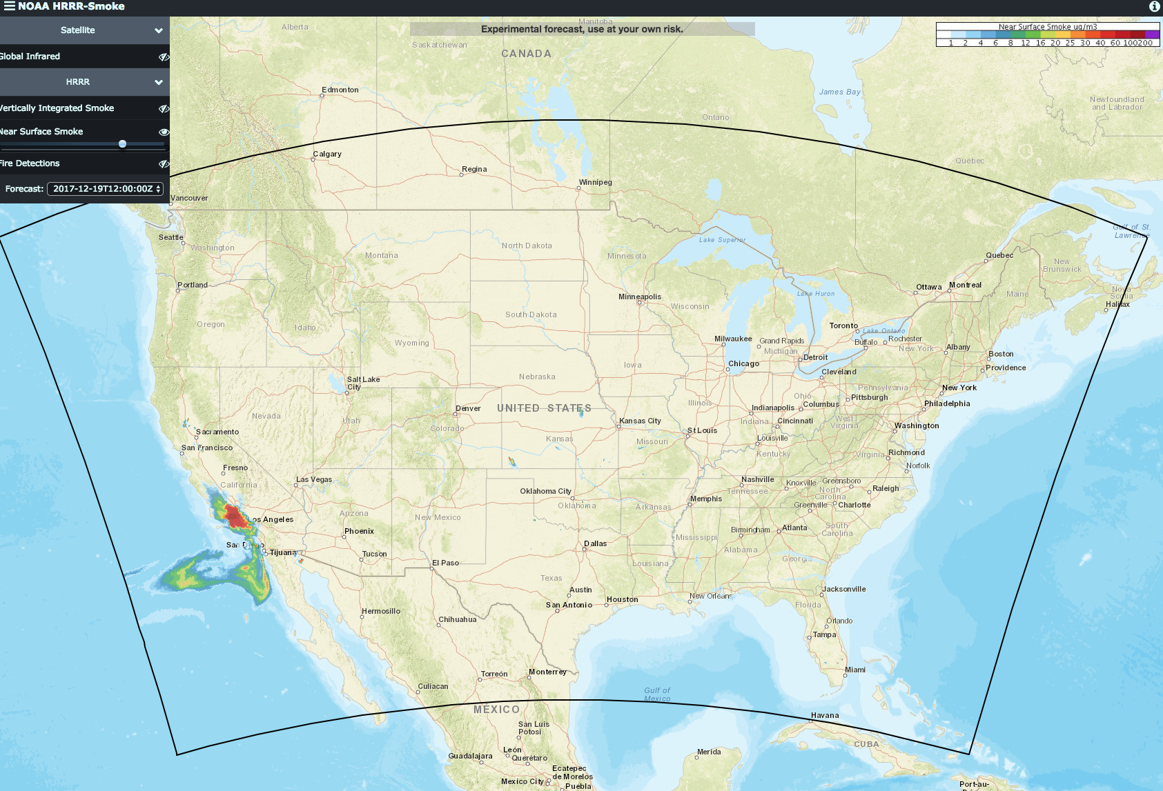
NOAA HRRR-Smoke
(High Resolution Rapid Refresh)
Coupled Meteorology/Smoke (WRF-Chem)
3-km, CONUS, Alaska
Primary PM2.5
Visible Infrared Imaging Radiometer Suite (VIIRS)
  fire activity
  fire radiative power (FRP)
Plume Rise – FRP
Emissions – FRP
00Z, 06Z, 12Z, 18Z
36-hrs
https://rapidrefresh.noaa.gov/hrrr/HRRRsmoke/

Slide 20
HRRR-Smoke Near-Surface PM2.5

Slide 21
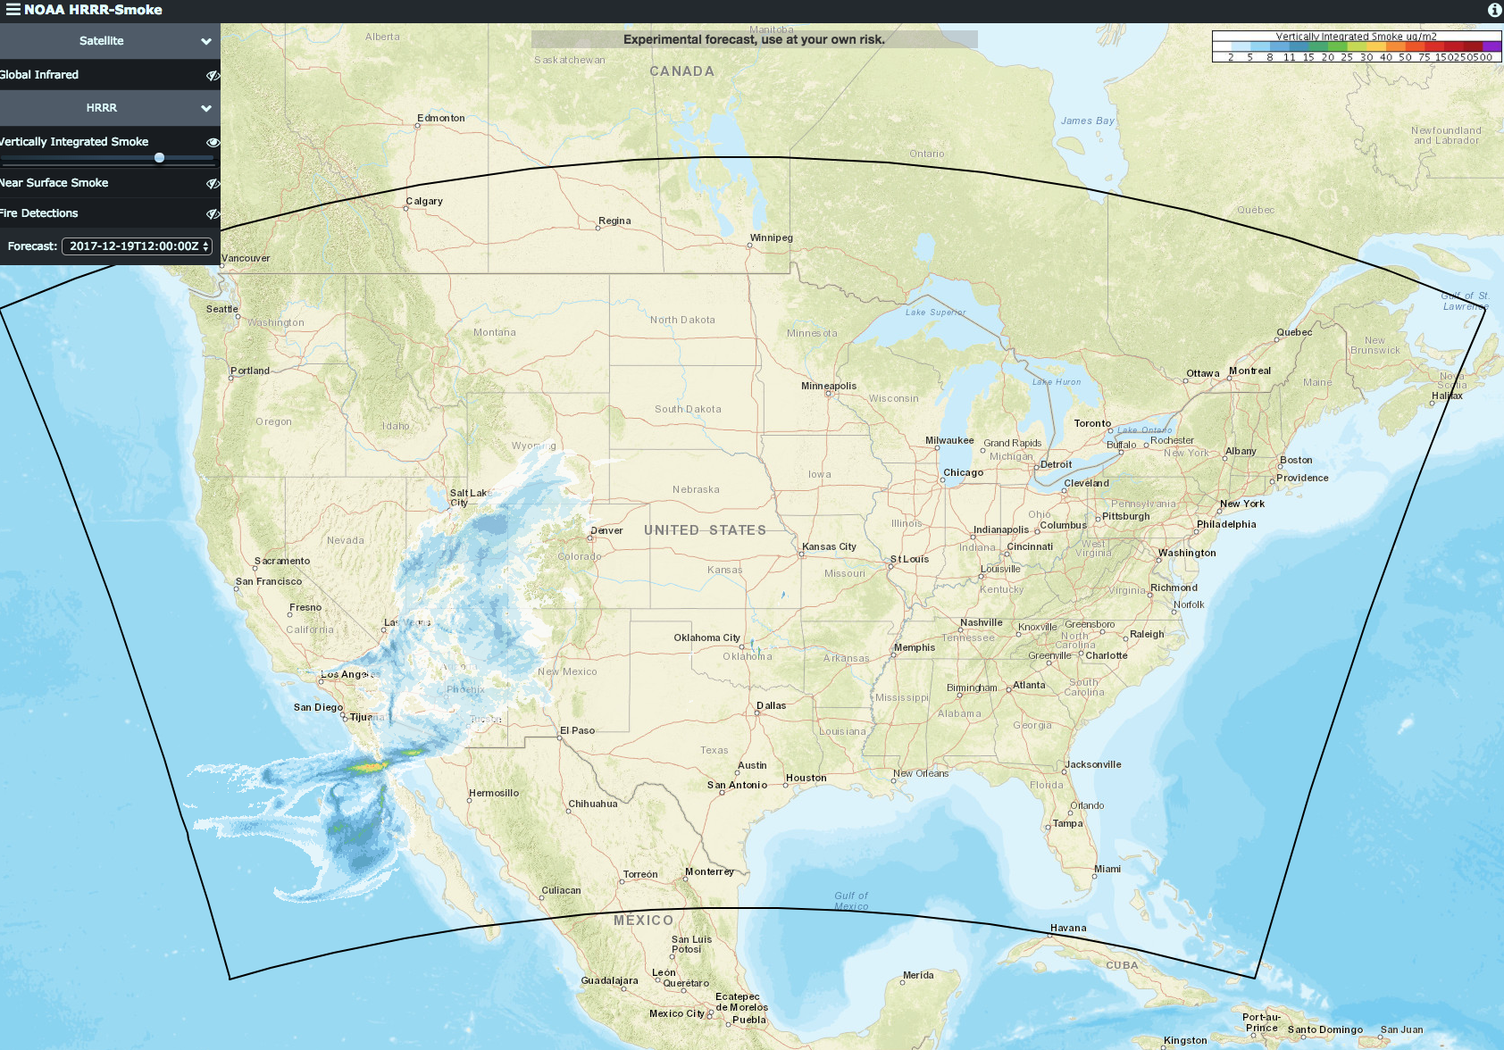
HRRR-Smoke Vertically Integrated PM2.5

Slide 22
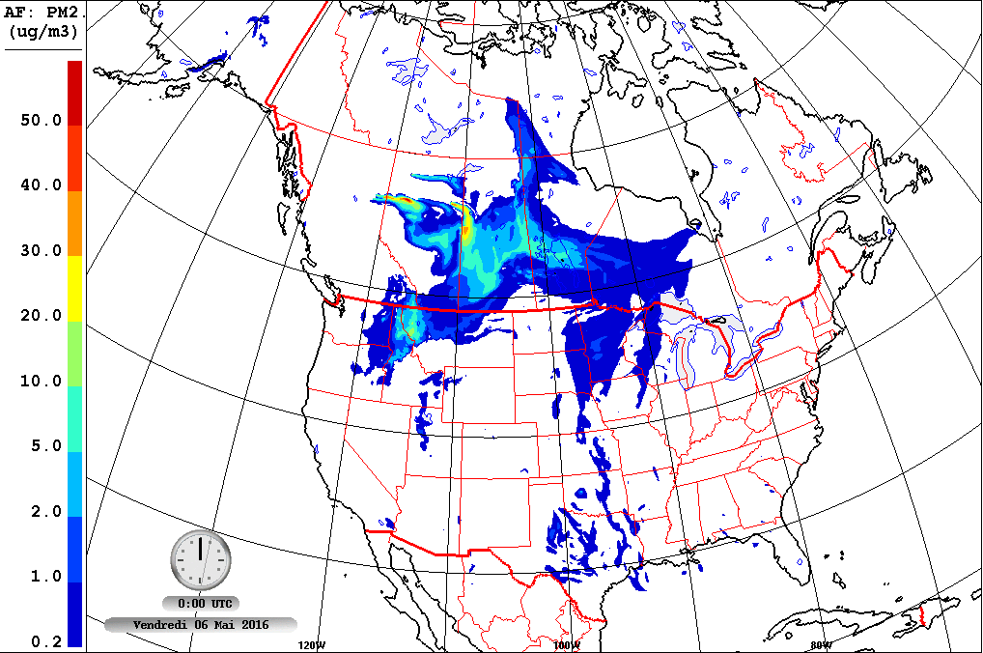

Firework – Canada
GEM-MACH
10-km
48-hrs
PM2.5 from only fires
CWFIS – Canadian Emissions
BlueSky – US Emissions
North America
Notes:
GEM-MACH Air Quality Model
00Z, 12Z
Using CWFIS and BlueSky for fire emissions
Ozone too, but that is not publically available

Slide 23
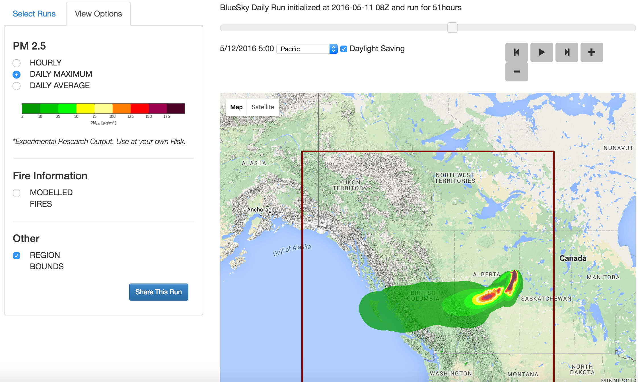

BlueSky Canada
BlueSky – Emissions and HYSPLIT
4-km, 12-km
48-hrs
CWFIS – Canadian Emissions
PM2.5 from fires
Notes:
12km national,
4km – west and east
HYSPLIT puff mode
00Z, 12Z

Slide 24

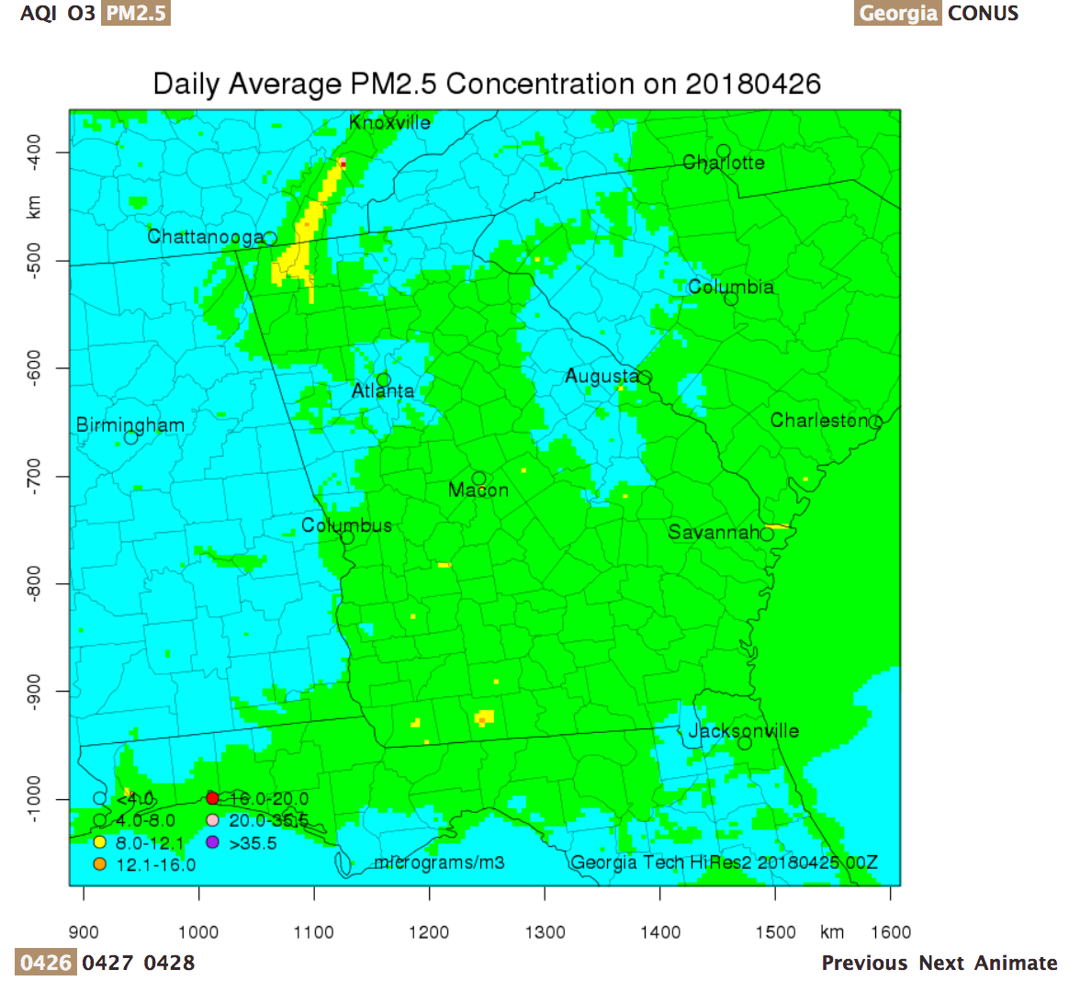
Georgia Tech
Prescribed Burning
4-km Georgia
12-km CONUS
AQI, O3, PM2.5

Slide 25
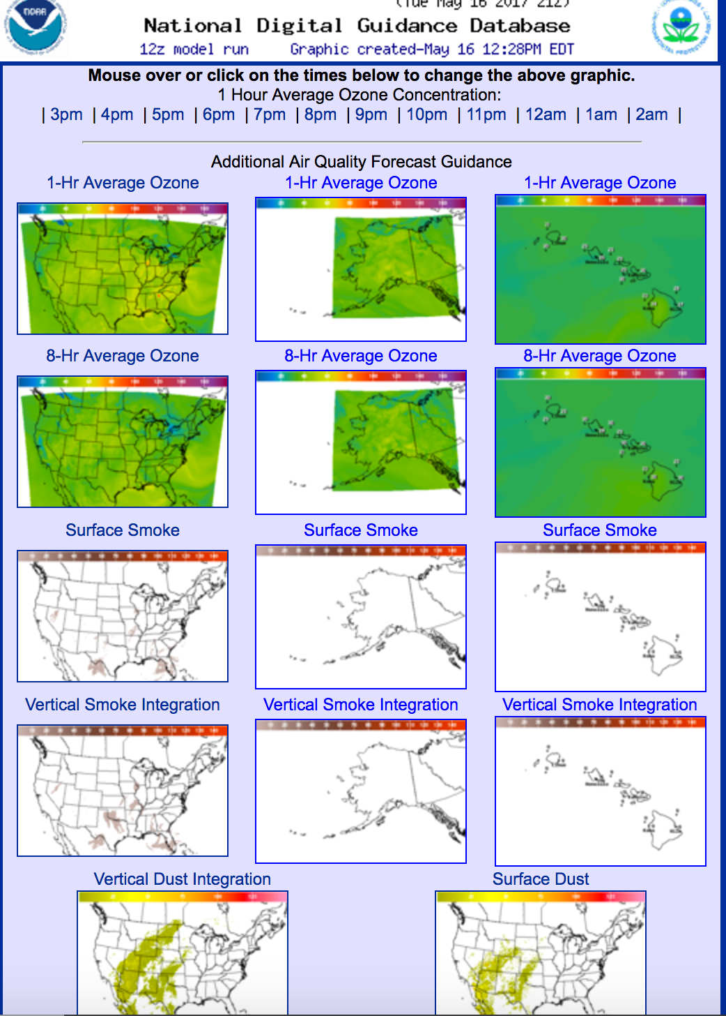
National Weather Service
HYSPLIT
CMAQ
Ozone, PM2.5
12-km
84-hours
BlueSky Fire Emissions

Slide 26
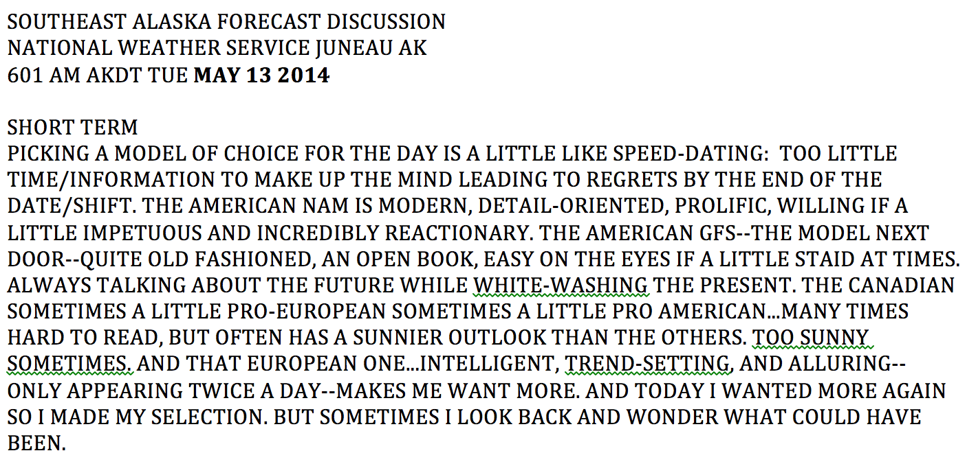
“Picking a model of choice for the day is a little like speed-dating: too little time/information to make up the mind leading to regrets by the end of the date/shift.”
-Wes Adkins, Meteorologist, National Weather Service, Juneau, AK
(picked up by the Washington Post, Slate.com, and others)

Slide 27
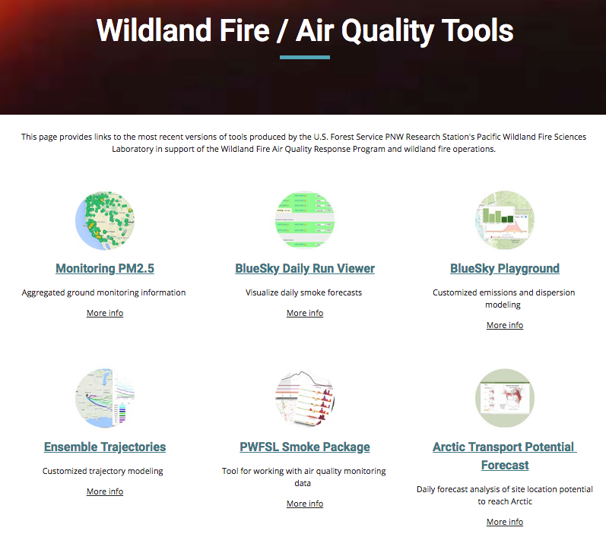
Trajectories https://tools.airfire.org/

Slide 28
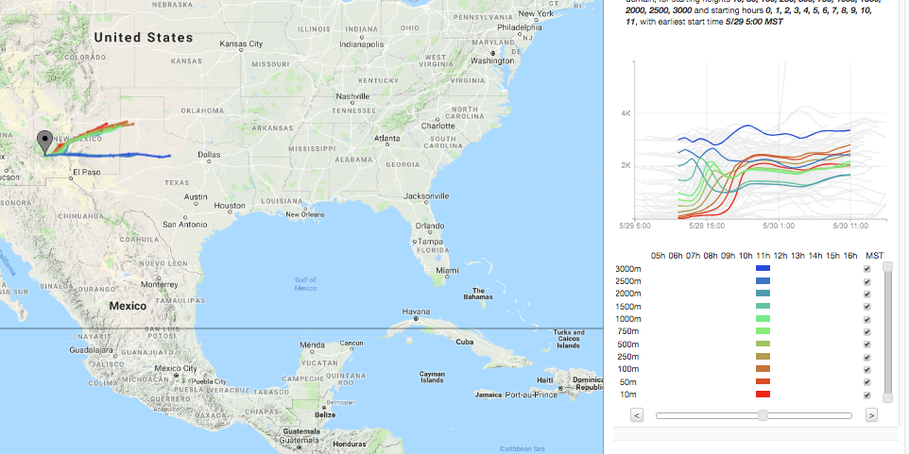
Smoke Trajectory Tool
Simulates where a parcel of air would travel
Based on a 3-d meteorological description of the atmosphere
Plume rise simulated by above ground-level release height
Trajectories do not include:
  chemistry
  smoke dispersion
  heat released from the fire
A trajectory will appear the same whether a burn is 40 acres or 4000 acre

Slide 29

Smoke Monitoring Tool (Permanent and Temporary Monitors) https://tools.airfire.org/

Slide 30
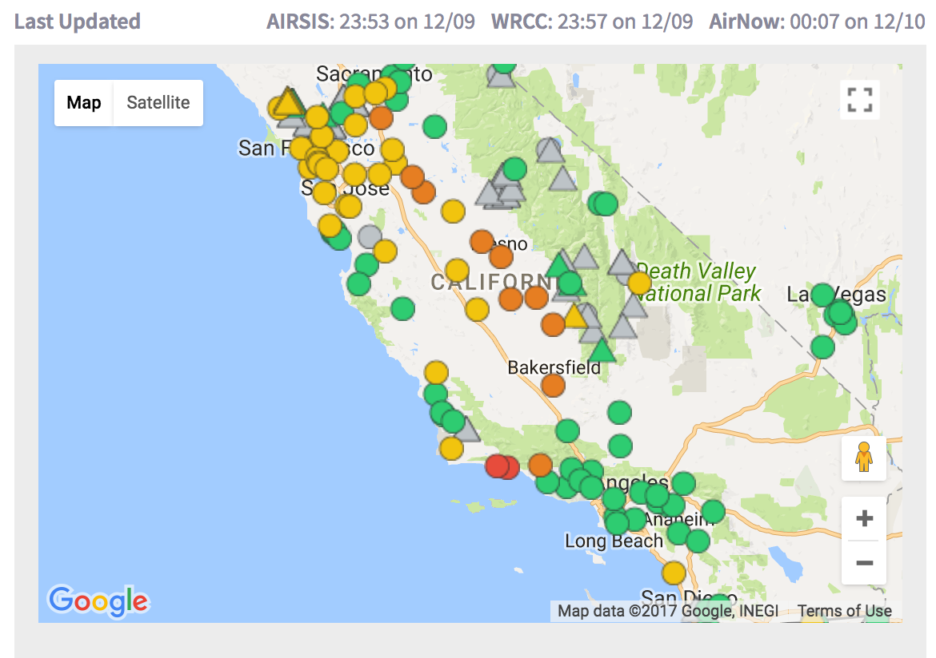
Monitoring Data Tool – Real-time PM2.5 Permanent and Temporary Monitors
https://tools.airfire.org/
Notes:
Data as of 20171210 8am PST

Slide 31
Monitoring Data Tool – Real-time PM2.5 Permanent and Temporary Monitors
https://tools.airfire.org/
Notes:
Data as of 20171210 8am PST

Slide 32
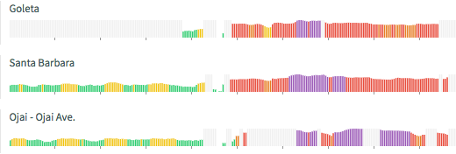
Monitoring Data Tool – Real-time PM2.5 Permanent and Temporary Monitors
https://tools.airfire.org/
Notes:
Data as of 20171210 8am PST

Slide 33
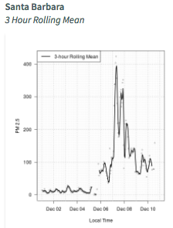
Monitoring Data Tool – Real-time PM2.5 Permanent and Temporary Monitors
https://tools.airfire.org/
Notes:
Data as of 20171210 8am PST

Slide 34
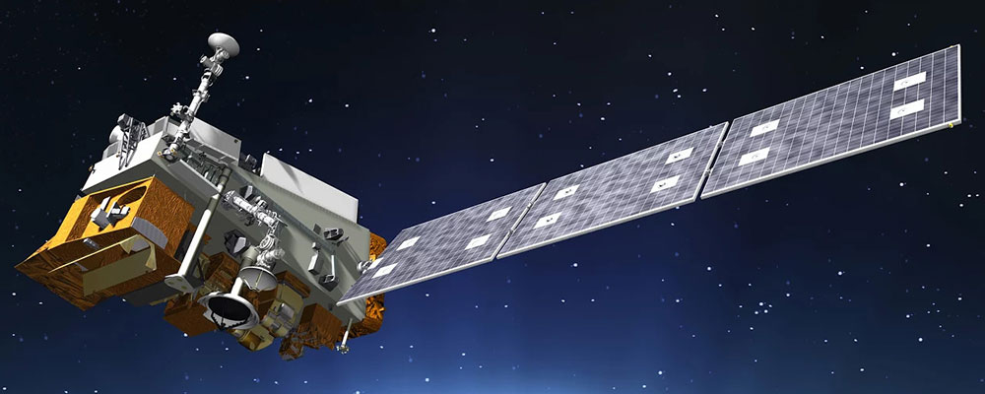
Satellite Information
NASA WORLDVIEW
https://worldview.earthdata.nasa.gov/
Infusing Satellite Data into Environmental Applications (IDEAS)
https://www.star.nesdis.noaa.gov/smcd/spb/aq/
Enhanced Infusing Satellite Data into Environmental Applications (eIDEAS)
https://www.star.nesdis.noaa.gov/smcd/spb/aq/eidea/index.php
GOES-16
http://rammb-slider.cira.colostate.edu/?sat=goes-16&sec=conus&x=4999.95458984375&y=4999.95458984375&z=0&im=12&ts=1&st=0&et=0&speed=130&motion=loop&map=1&lat=0&p%5B0%5D=16&opacity%5B0%5D=1&hidden%5B0%5D=0&pause=0&slider=-1&hide_controls=0&mouse_draw=0&s=rammb-slider
Stay tuned for more
  GOES-16 Launched 11/2016 – in GOES East Position 11/2017
  NOAA-20 Launched 11/18/2017
  New/future GOES West – Launched March 2018
  TEMPO

Slide 35
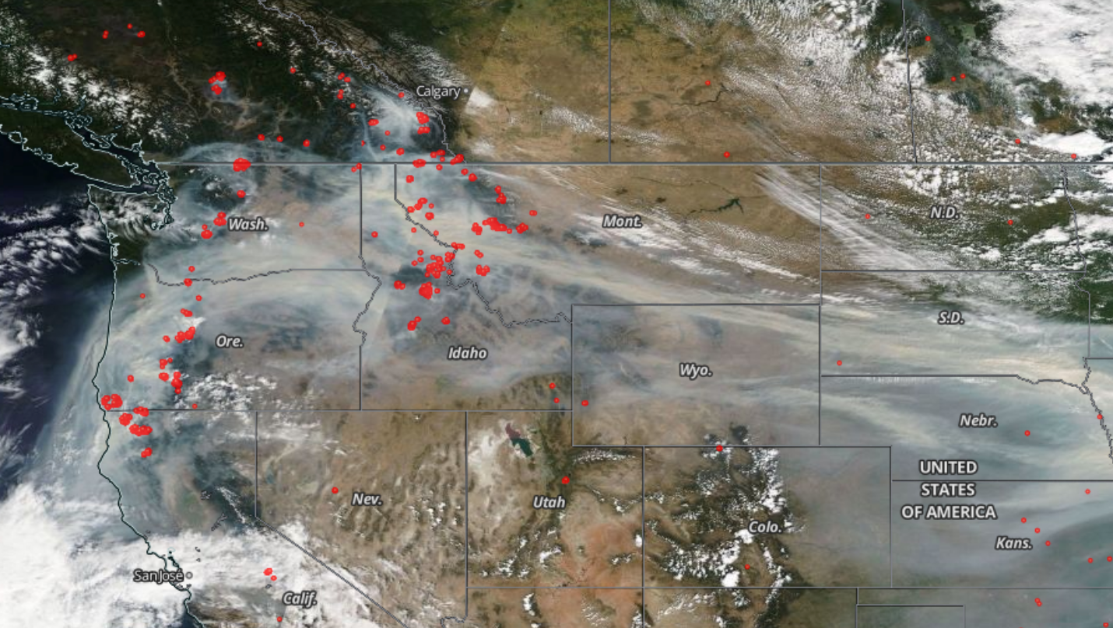
NASA Worldview 9/4/2017

Slide 36
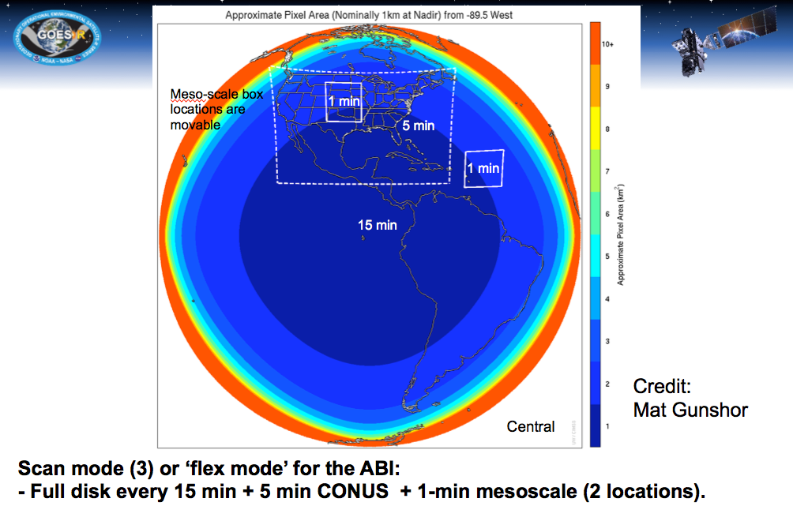
GOES-16

Slide 37
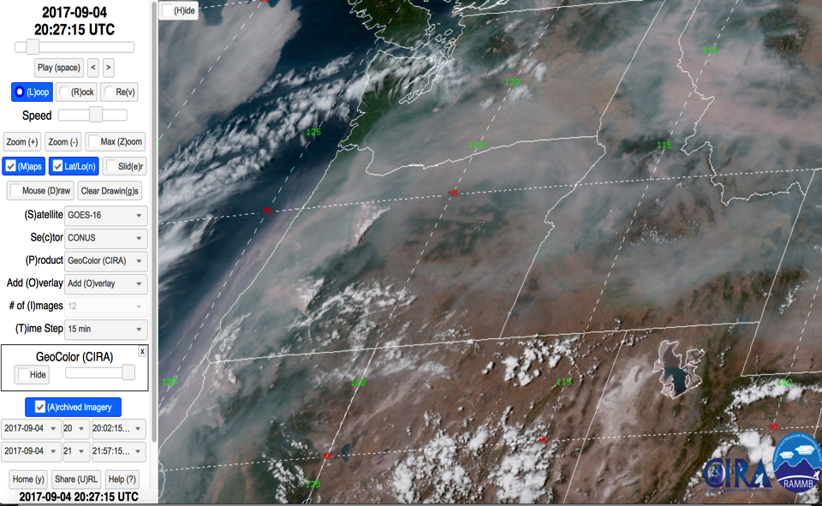
GOES-16 9/4/2017 13:27 PDT

Slide 38
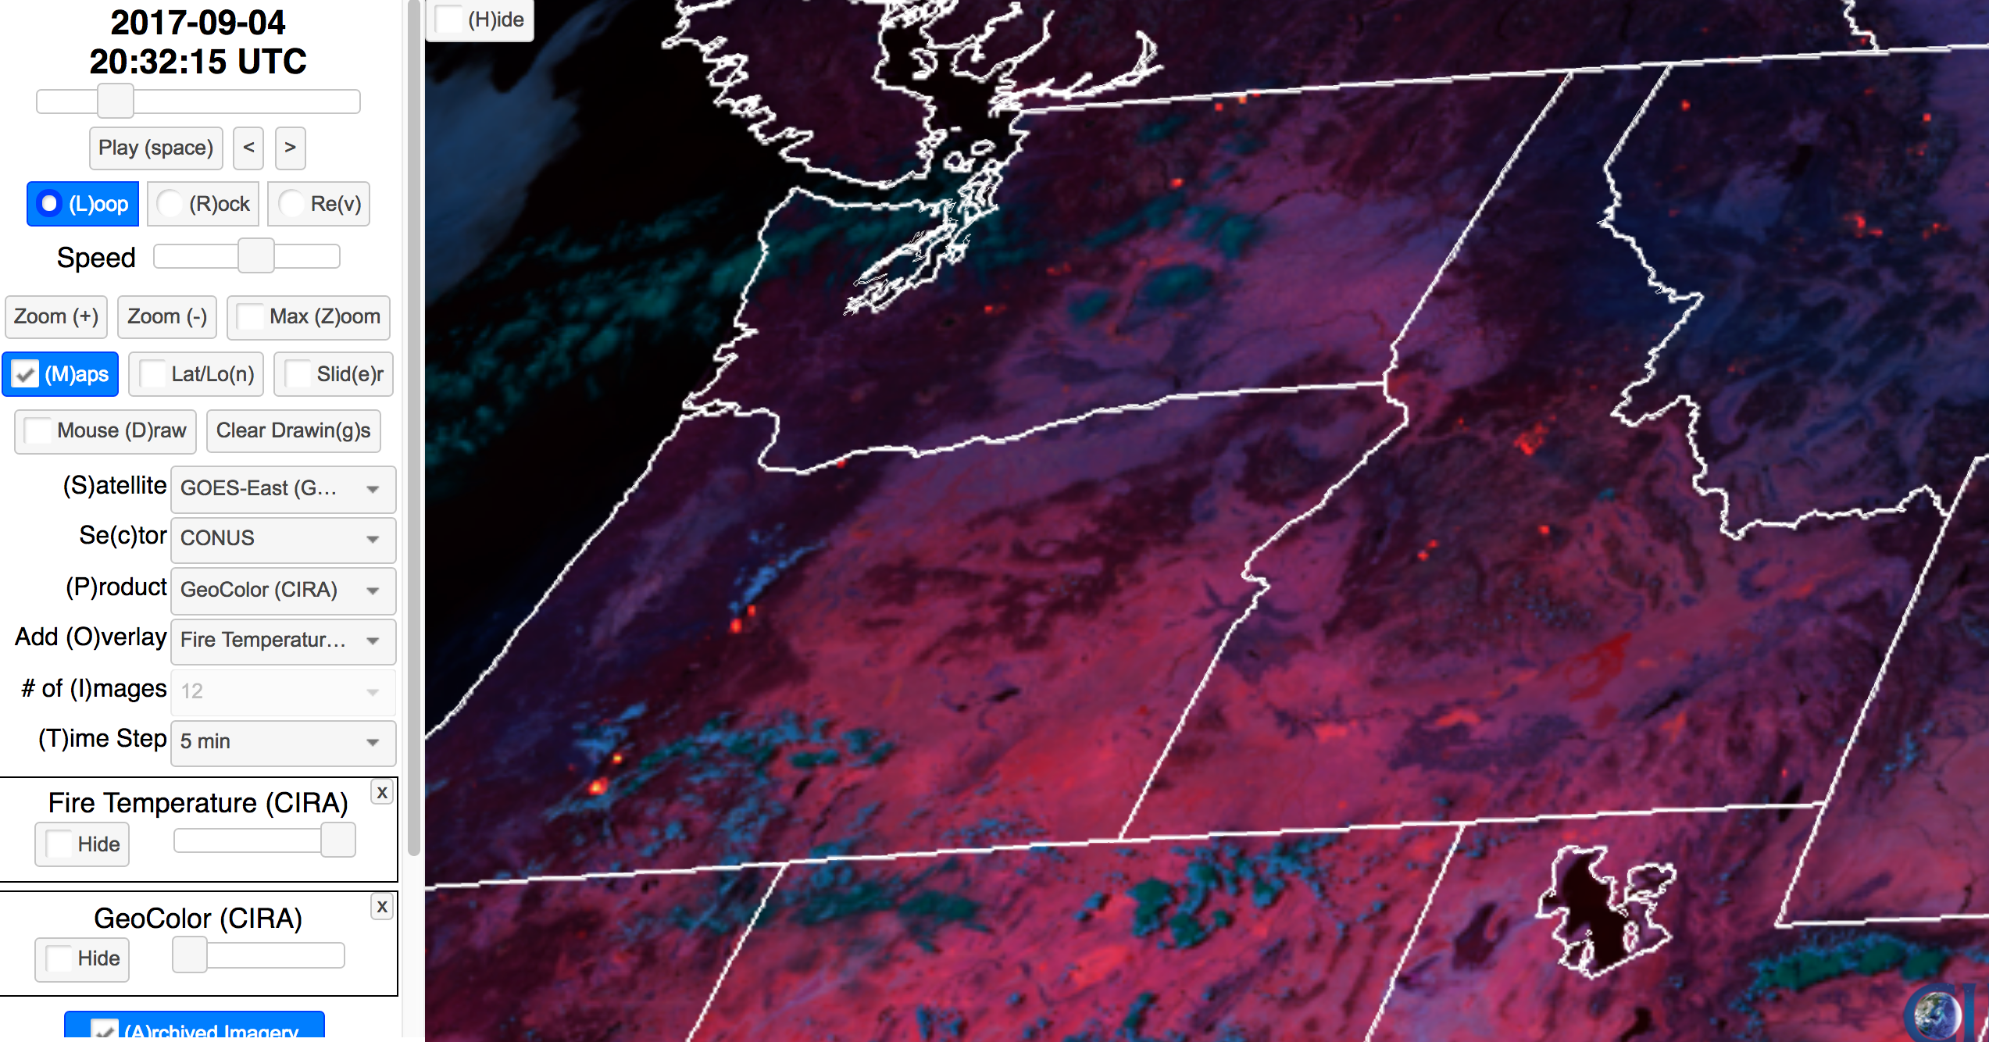
GOES-16 9/4/2017 13:32 PDT

Slide 39
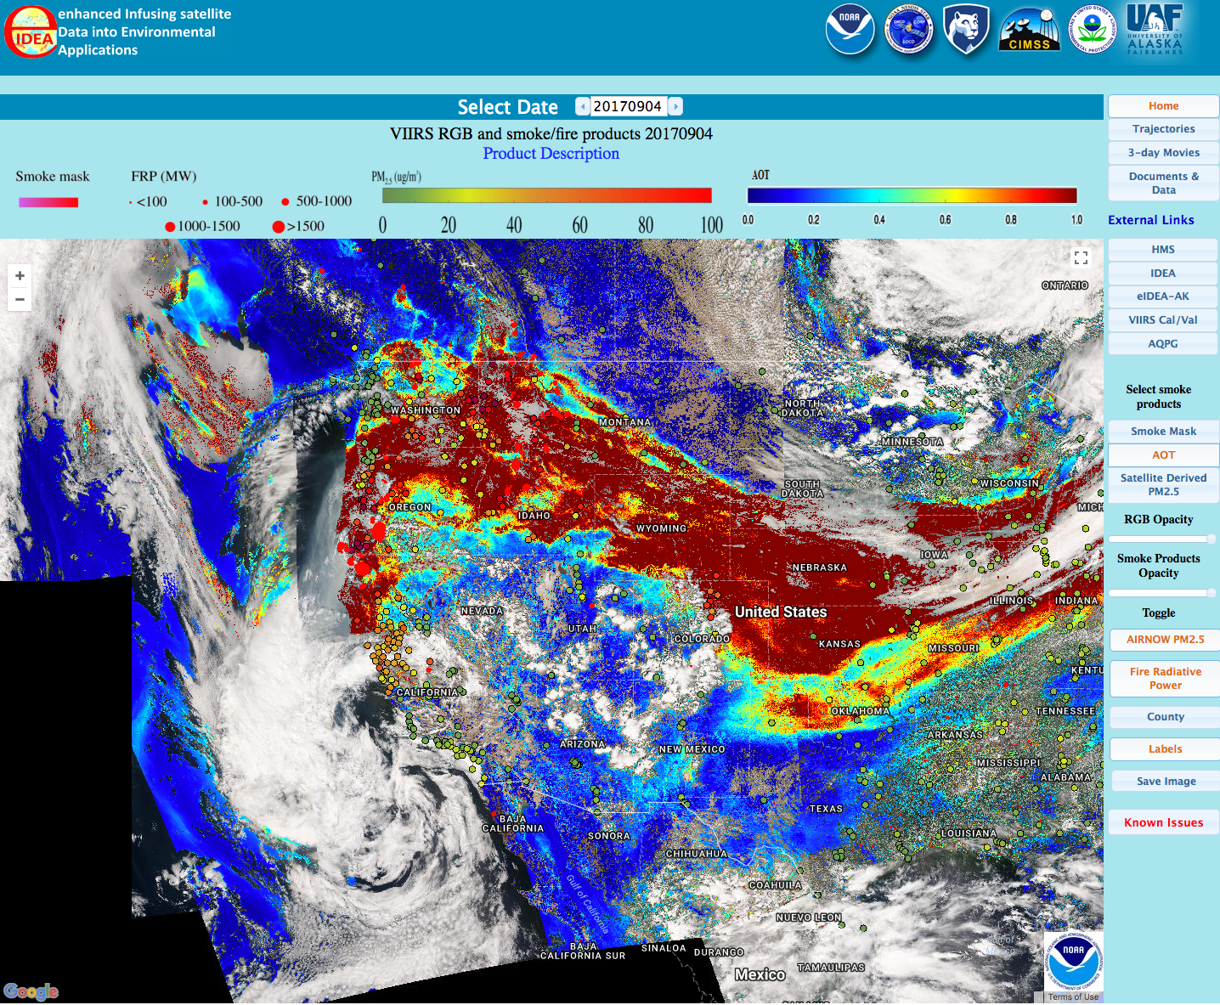
Enhanced Infusing Satellite Data for Environmental Applications (eIDEAS)

Slide 40
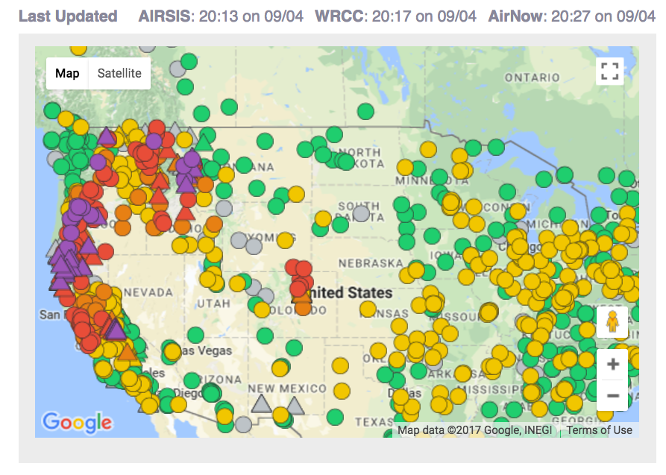
Notes:
TODO: get GOES-16, do a CANSAC-2km analysis, 2017090300, 2017090312, 2017090400

Slide 41
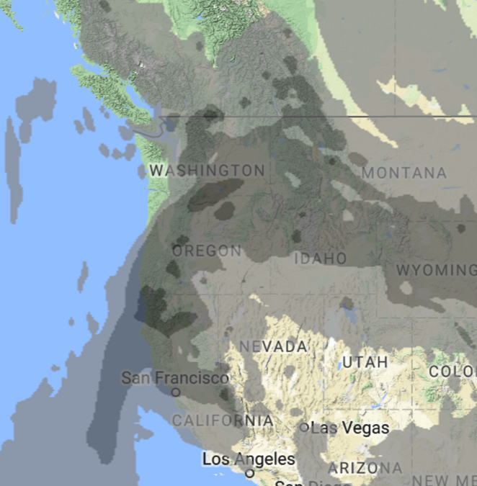
9/4/2017 13:27 PDT
GFS
Column Average

Slide 42
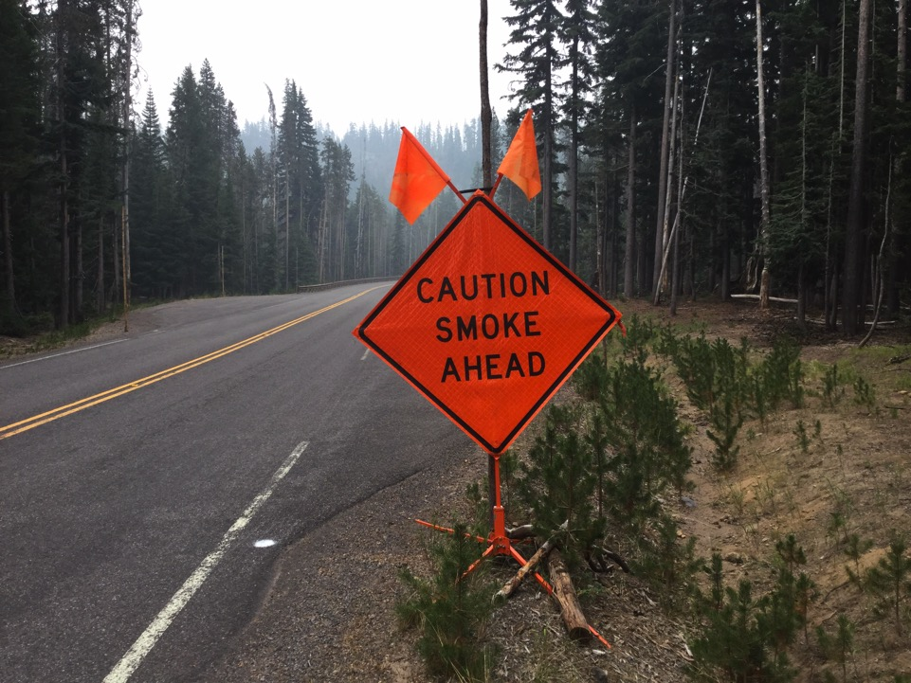

Putting on Your Smoke Glasses

Slide 43
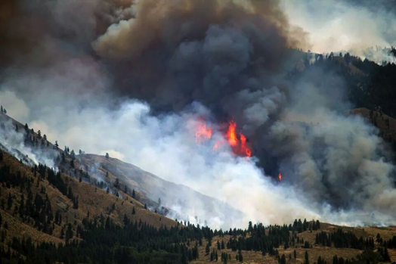
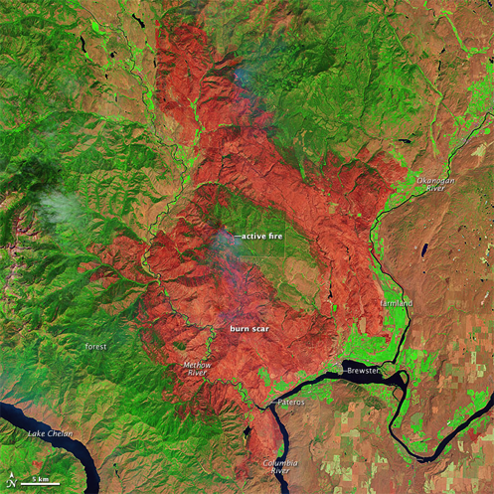
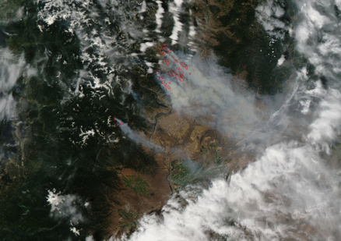
Carlton Complex Washington State 2014
250,000 acres
http://en.wikipedia.org/wiki/2014_Washington_state_wildfires
Notes:
Use this example to talk about: grid resolution, comparing with monitoring data, timing of impacts and met models being off, calibrating your brain/experience
Example of: our production runs, how they get used by the ARA program for wildfires

Slide 44
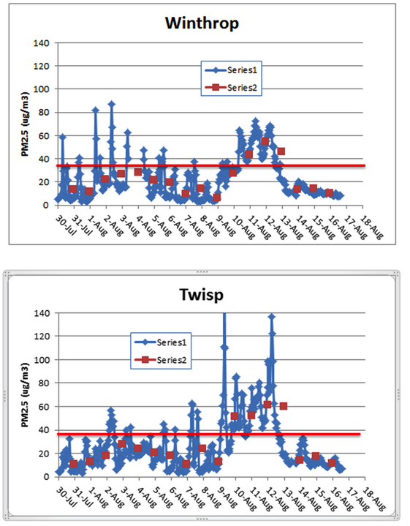
Carlton Complex August 2014
Washington Smoke Blog
On this gorgeous, clear day with no smoke, let's take a look at the differences between two air quality monitors located less than 9 miles apart in the same Methow Valley. The blue graphs indicate 1-hr average concentrations of PM2.5 while the red data points are 24-hr averages. Note that while the 24-hr values trended rather similar for the two sites (expected as they are spatially close) the peak 1-hr values differed greatly!
Posted by Mike Broughton, FWS, ARA
Notes:
Read the smoke blog to the class, then say, lets take it a step further and look at the models.
http://www.wasmoke.blogspot.com/search?updated-max=2014-08-18T11:08:00-07:00&max-results=8&start=4&by-date=false
Talk about 1-hr and 24-hr concentrations. NAAQS are a 24-hr std. Does smoke stay the same over a 24-hr period? Why or why not?
Use this example to talk about: grid resolution, comparing with monitoring data, timing of impacts and met models being off, calibrating your brain/experience
http://kcts9.org/programs/in-close/environment/wildfires-and-climate-change
http://kcts9.org/programs/in-close/environment/carlton-complex-progression-map

Slide 45
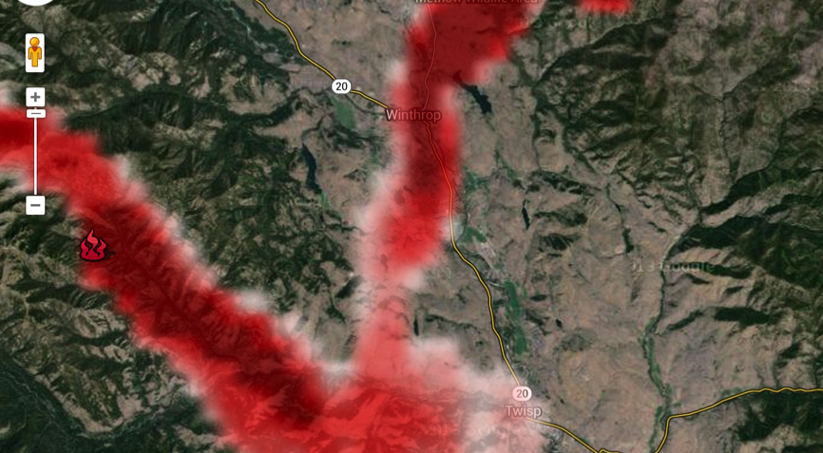
Carlton Complex, 8/4/2014 6am, 1.33 km Domain
Winthrop
Twisp
Notes:
Meteorology – what if it is off by 30 degrees?
The obs showed Twisp getting hit harder, yet BlueSky typically hit Winthrop harder – work in process

Slide 46
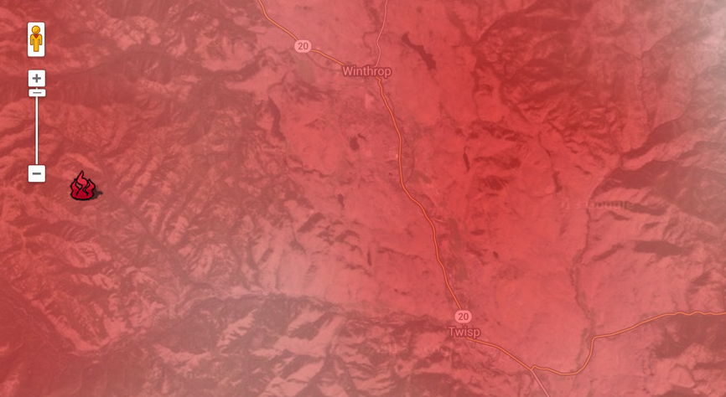
Carlton Complex, 8/4/2014 6am, 12 km Domain
Winthrop
Twisp
Notes:
Meteorology – what if it is off by 30 degrees? Does it matter so much with this resolution?

Slide 47
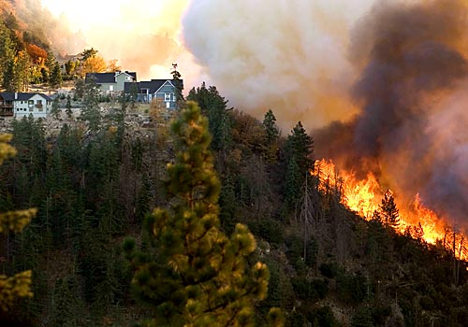
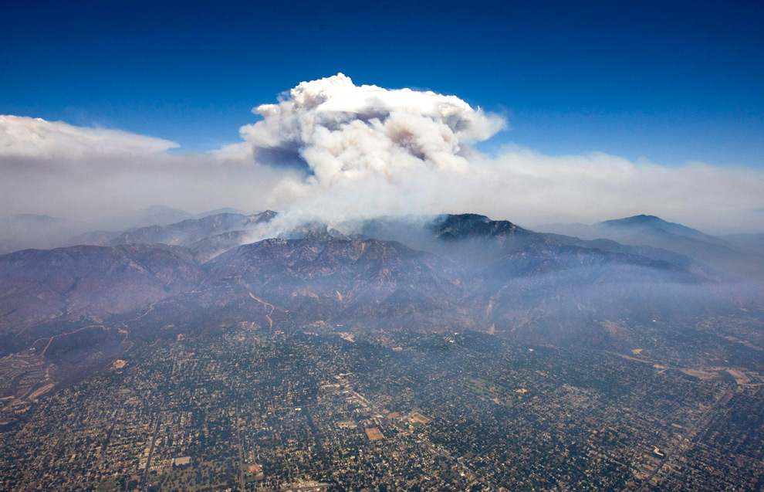
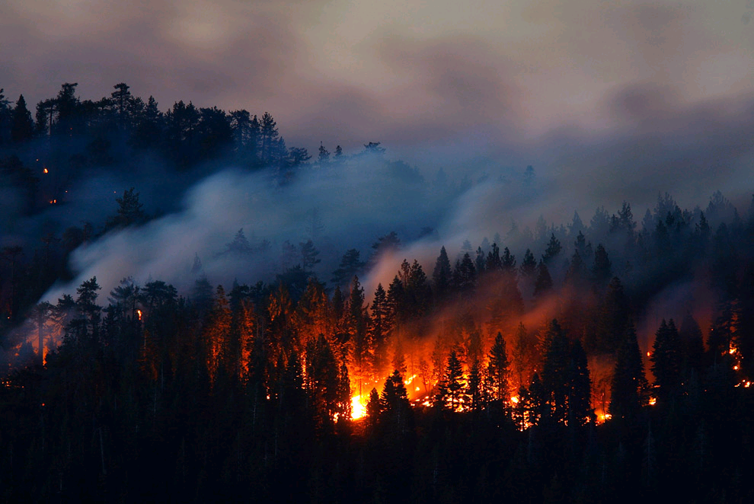











Thank you
Special thanks to our funders in this work:
More information:
Sim Larkin
larkin@fs.fed.us
Susan O’Neill
smoneill@fs.fed.us

