Slide 1
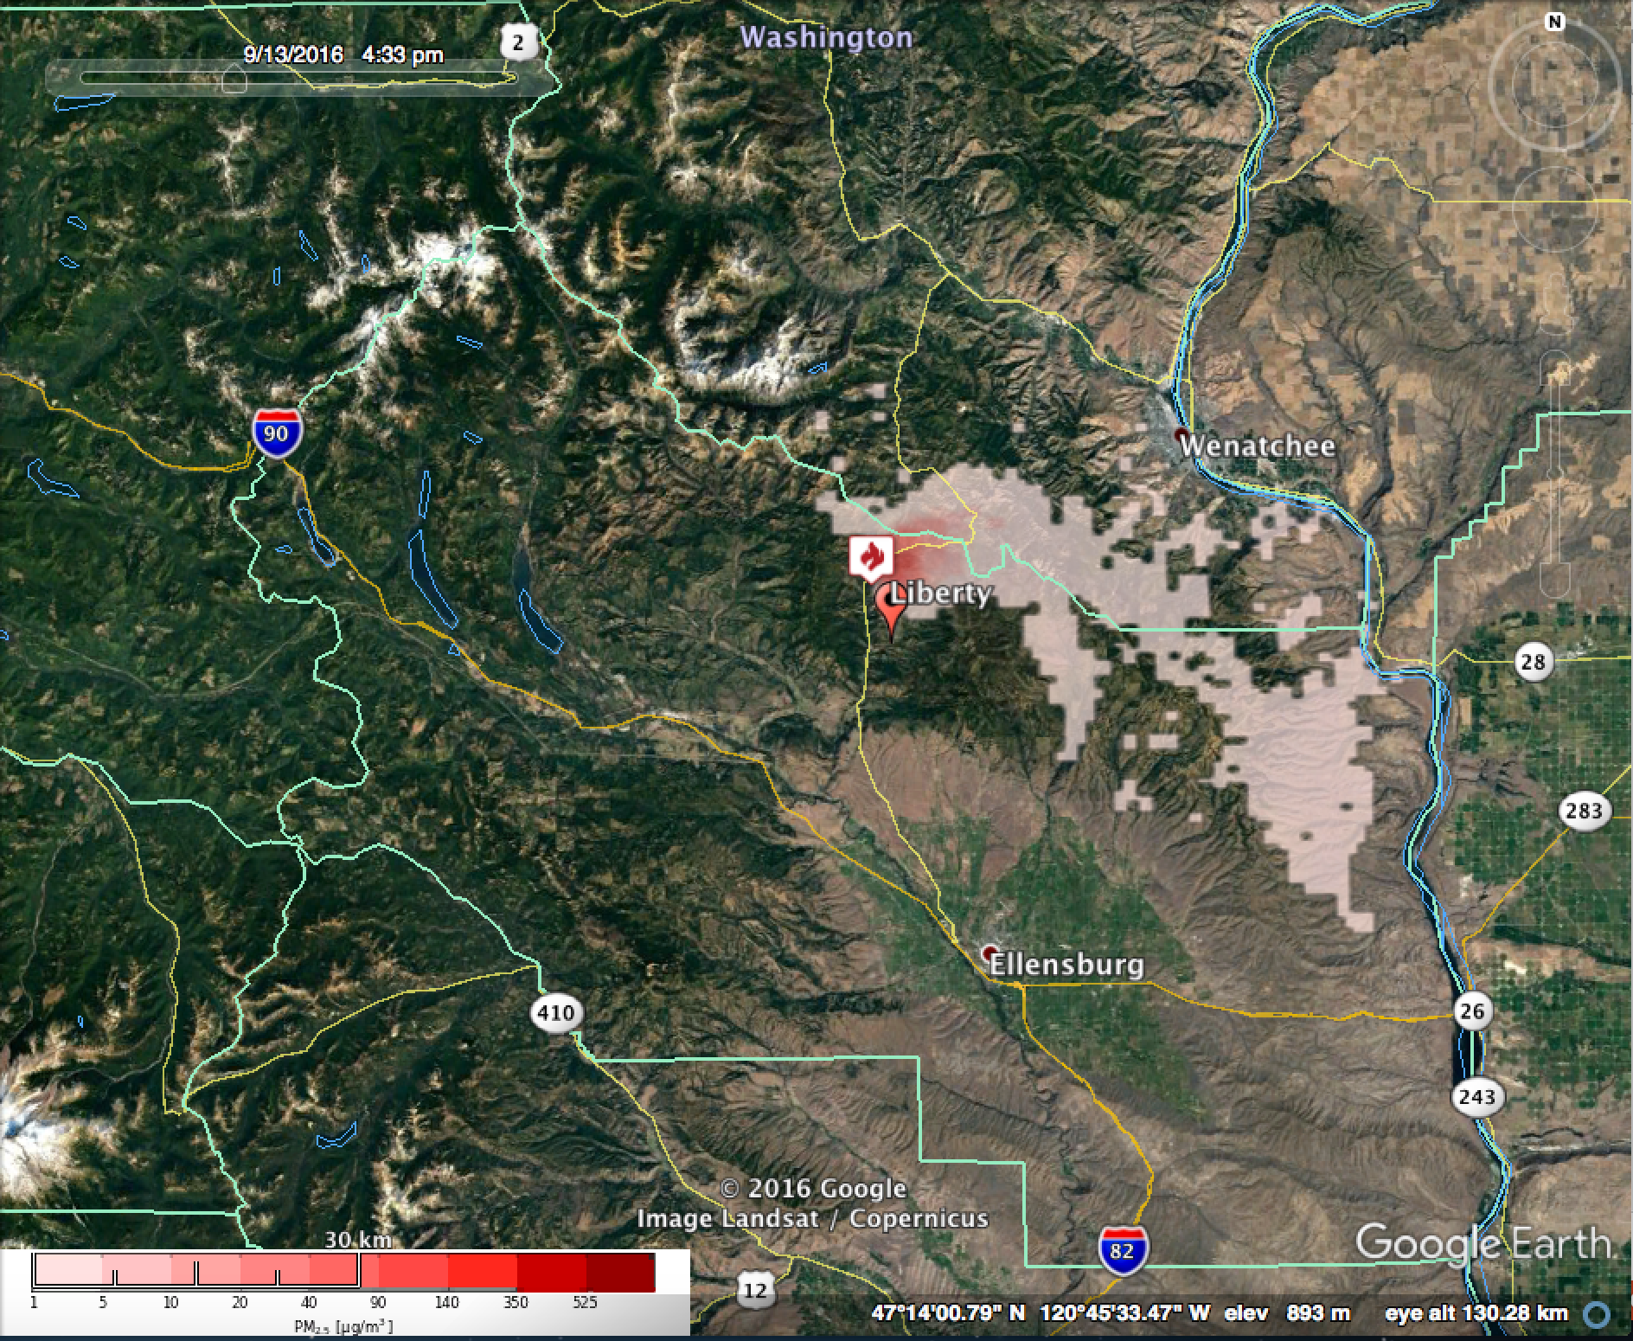
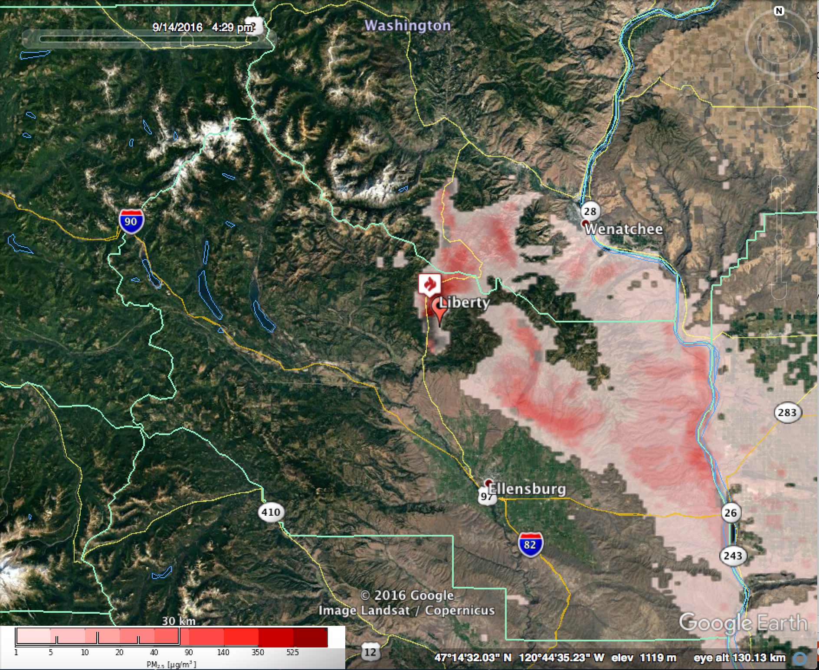
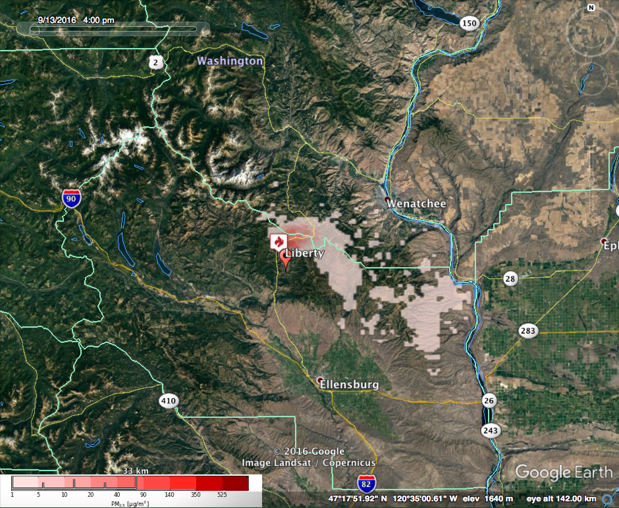
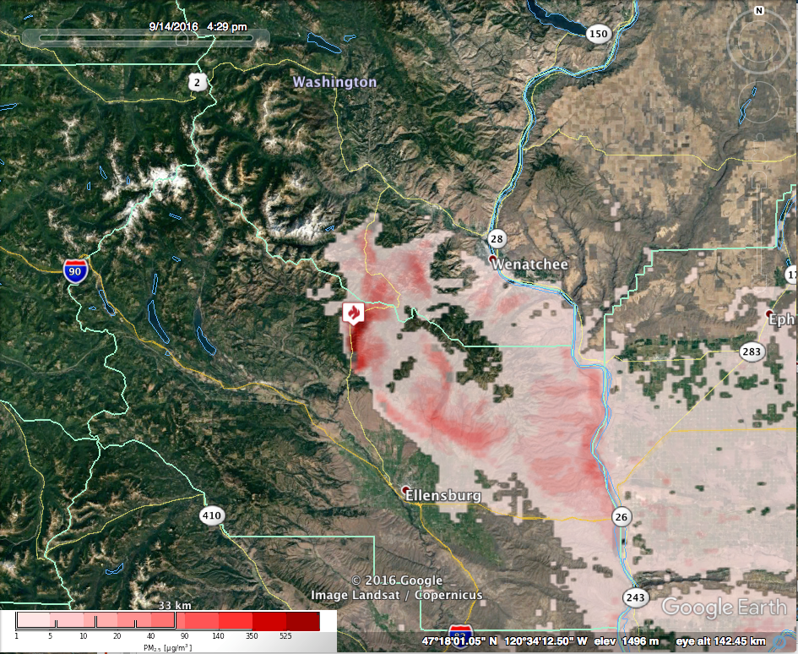
Orion Unit2 Burn 9/14
Liberty monitor
Maximum PM_{2.5} 24-48 hour forecast
00Z 9/14 - 00Z 9/15 (2ndDay)
Initialization 9/13 00Z
Maximum PM_{2.5} 48-72 hour forecast
00Z 9/15 – 00Z 9/16 (2ndDay)
Initialization 9/13 00Z
Top Row: BSF initialization 9/13 00Z; Burn ignited 2nd day (11AM PDT 14 Sept)
Maximum PM_{2.5} 0-24 hour forecast
00Z 9/14 – 00Z 9/15
Initialization 9/14 00Z
Maximum PM_{2.5} 24-48 hour forecast
00Z 9/15 - 00Z 9/16
Initialization 9/14 00Z
Bottom Row: BSF initialization 9/14 00Z; Burn ignited 1st day (11AM PDT 14 Sept)
Notes:
Daily maximum pm2.5 BlueSky predictions for day 2, and day 3, initialized on 00Z 9/13/2016 (top row) and day 1 and day2, initialized on 00Z 9/14/2016 (bottom row). The fire ignition time is the same for both runs (9/14 11PDT). For the top row, the fire was ignited on the 2nd day of the model run; for the bottom row, the fire was ignited on the 1st day of the run.

Slide 2
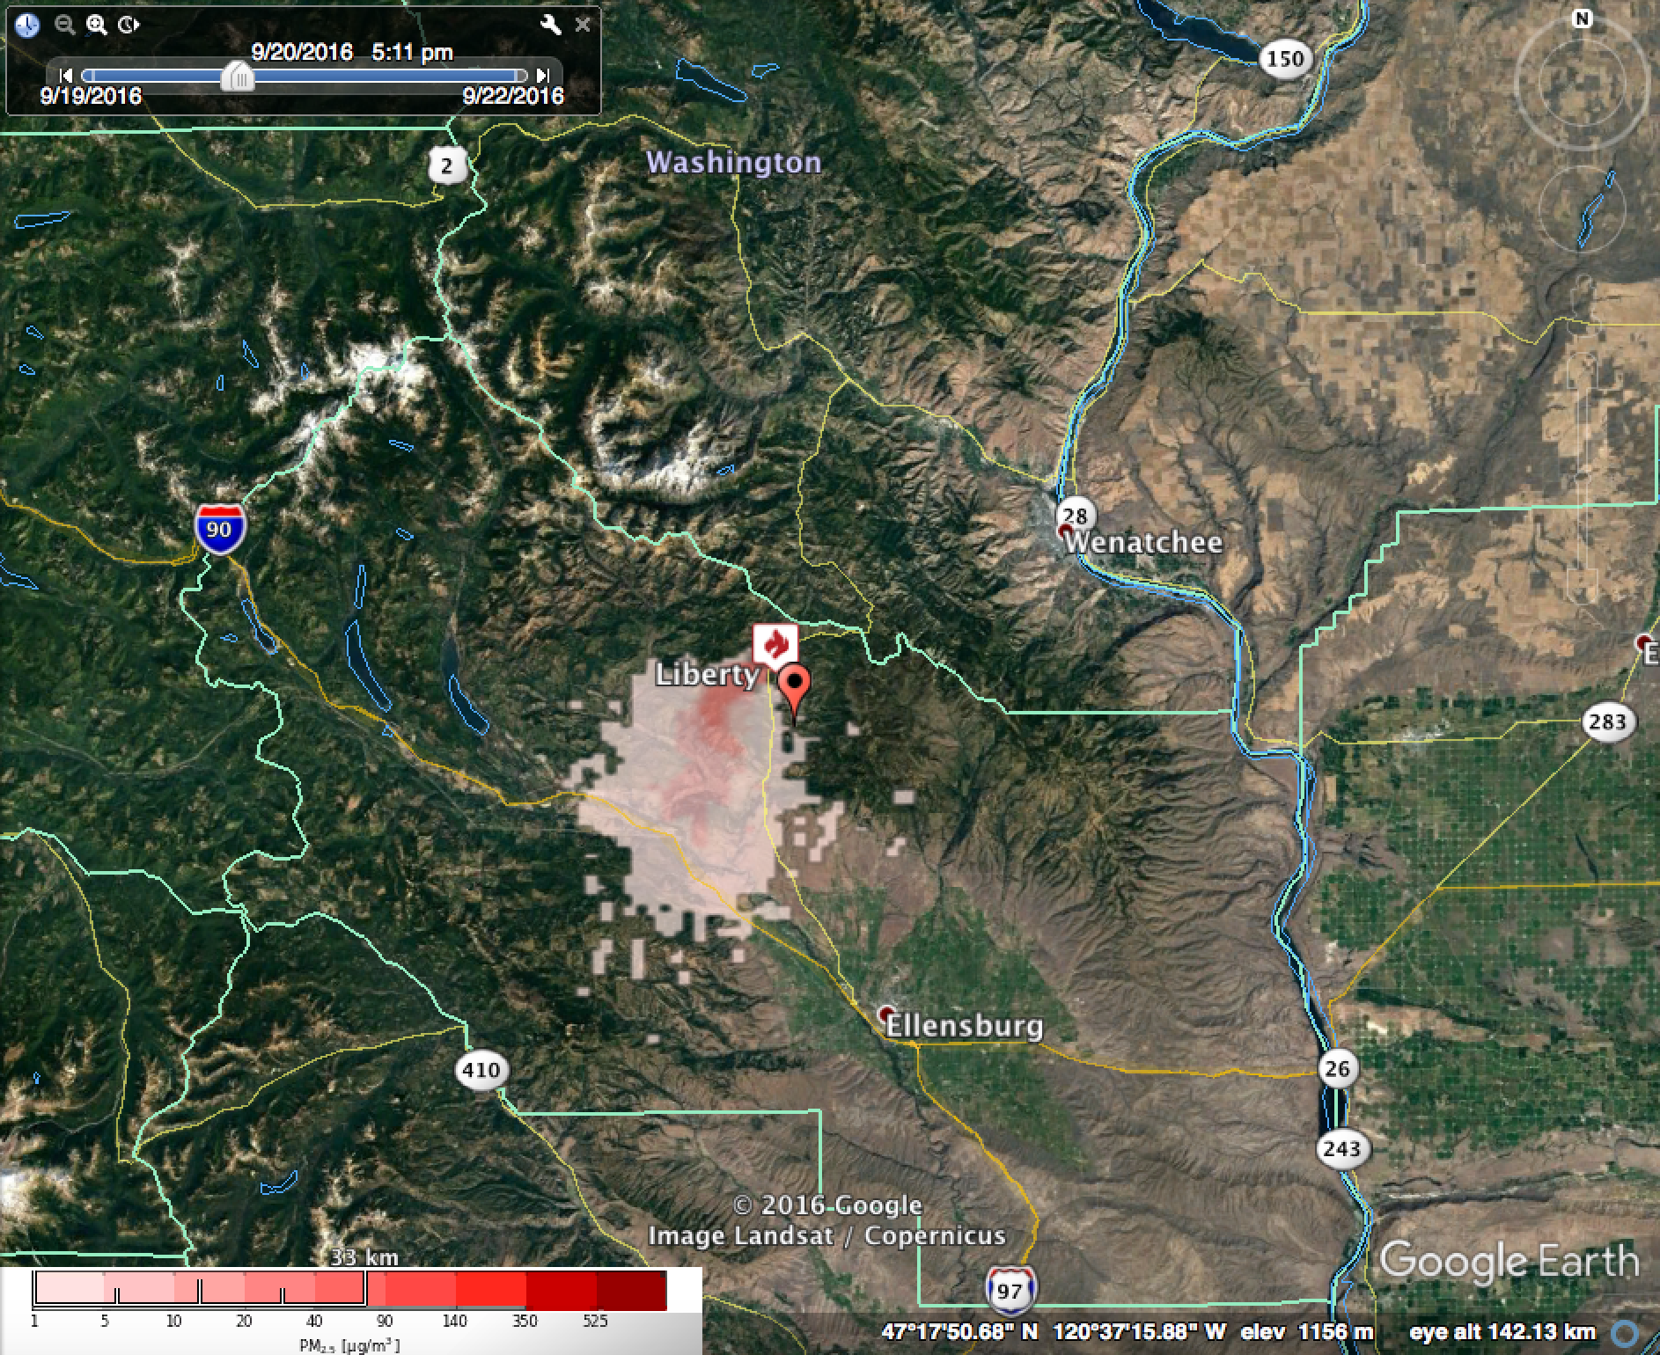
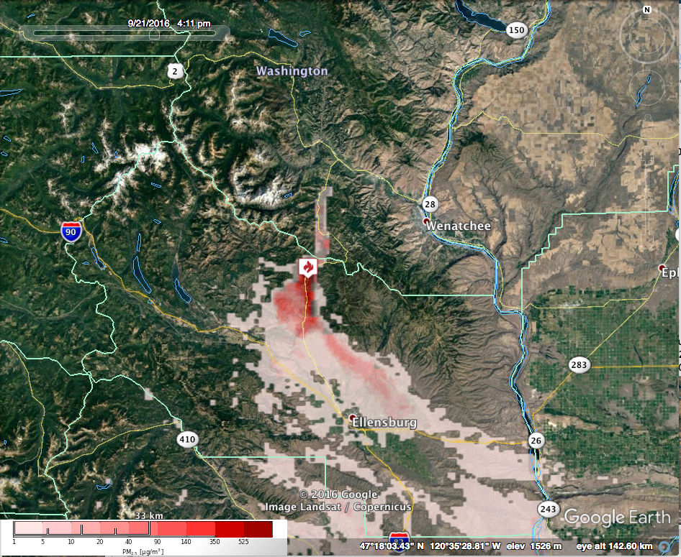
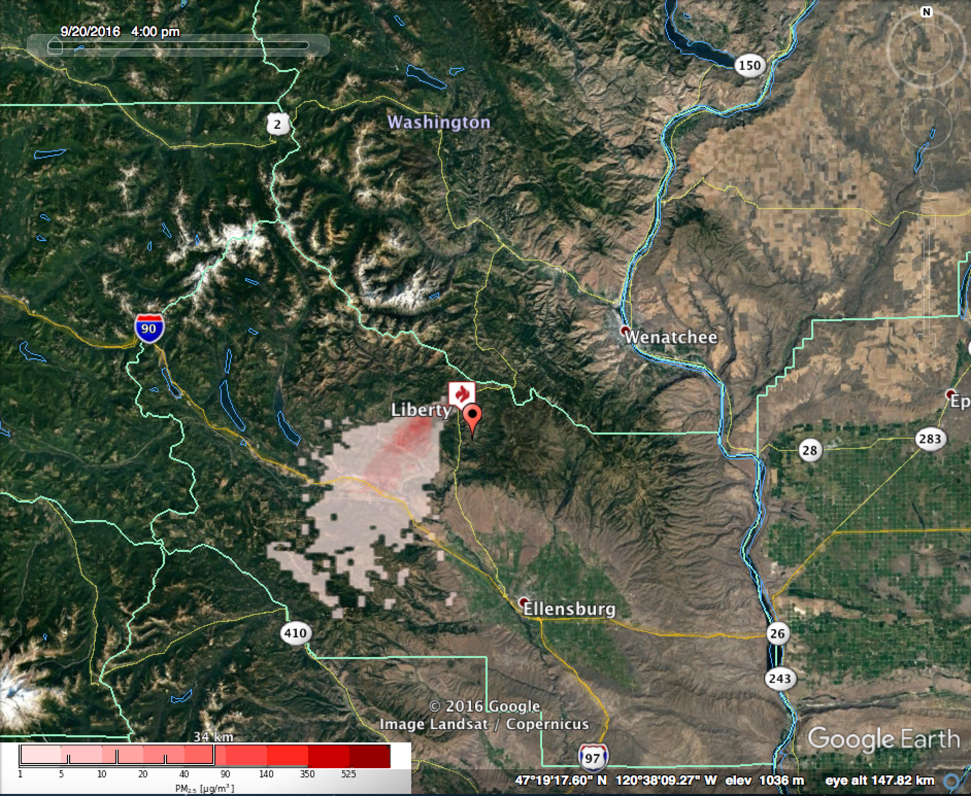
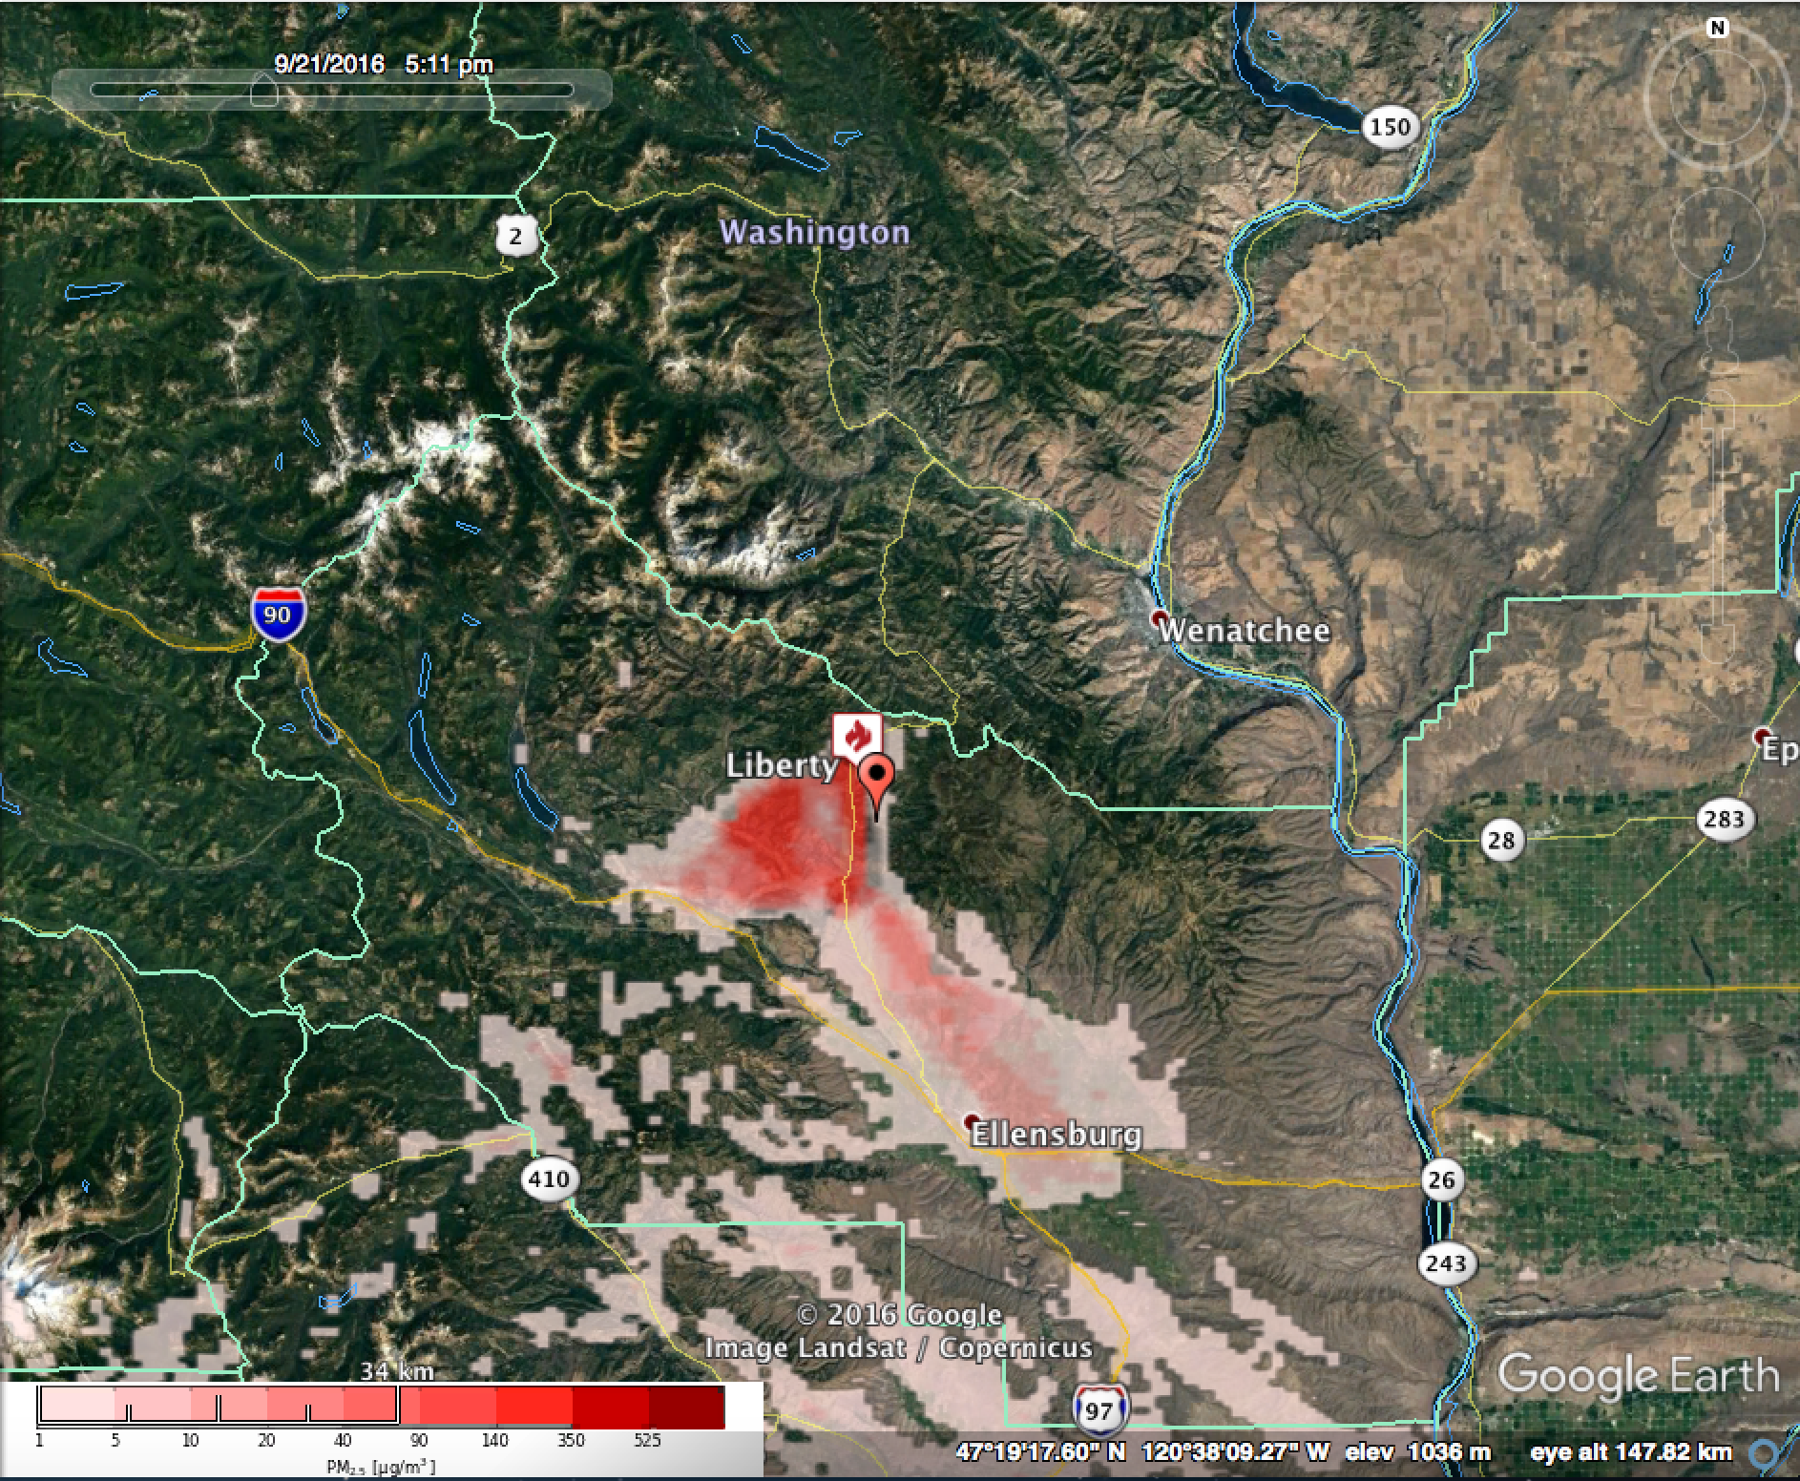
Maximum PM_{2.5} 24-48 hour forecast
00Z 9/21 00Z - 00Z 9/22 00Z (2ndDay)
Initialization: 9/20 00Z
Maximum PM_{2.5} 48-72 hour forecast
00Z 9/22 00Z - 00Z 9/23 00Z (2ndDay)
Initialization: 9/20 00Z
Top Row: BSF initialization 9/20 00Z; Burn ignited 2nd day (11AM PDT 21 Sept)
Maximum PM_{2.5} 12-24 hour forecast
00Z 9/21 - 00Z 9/22
Initialization: 9/21 00Z
Maximum PM_{2.5} 24-48 hour forecast
00Z 9/22 – 00Z 9/23
Initialization: 9/21 00Z
Bottom Row: BSF initialization 9/21 00Z; Burn ignited 1st day (11AM PDT 21 Sept)
Notes:
Daily maximum pm2.5 BlueSky predictions for day 2, and day 3, initialized on 00Z 9/20/2016 (top row) and day 1 and day2, initialized on 00Z 9/21/2016 (bottom row). The fire ignition time is the same for both runs (9/21 11PDT). For the top row, the fire was ignited on the 2nd day of the model run; for the bottom row, the fire was ignited on the 1st day of the run.

Slide 3
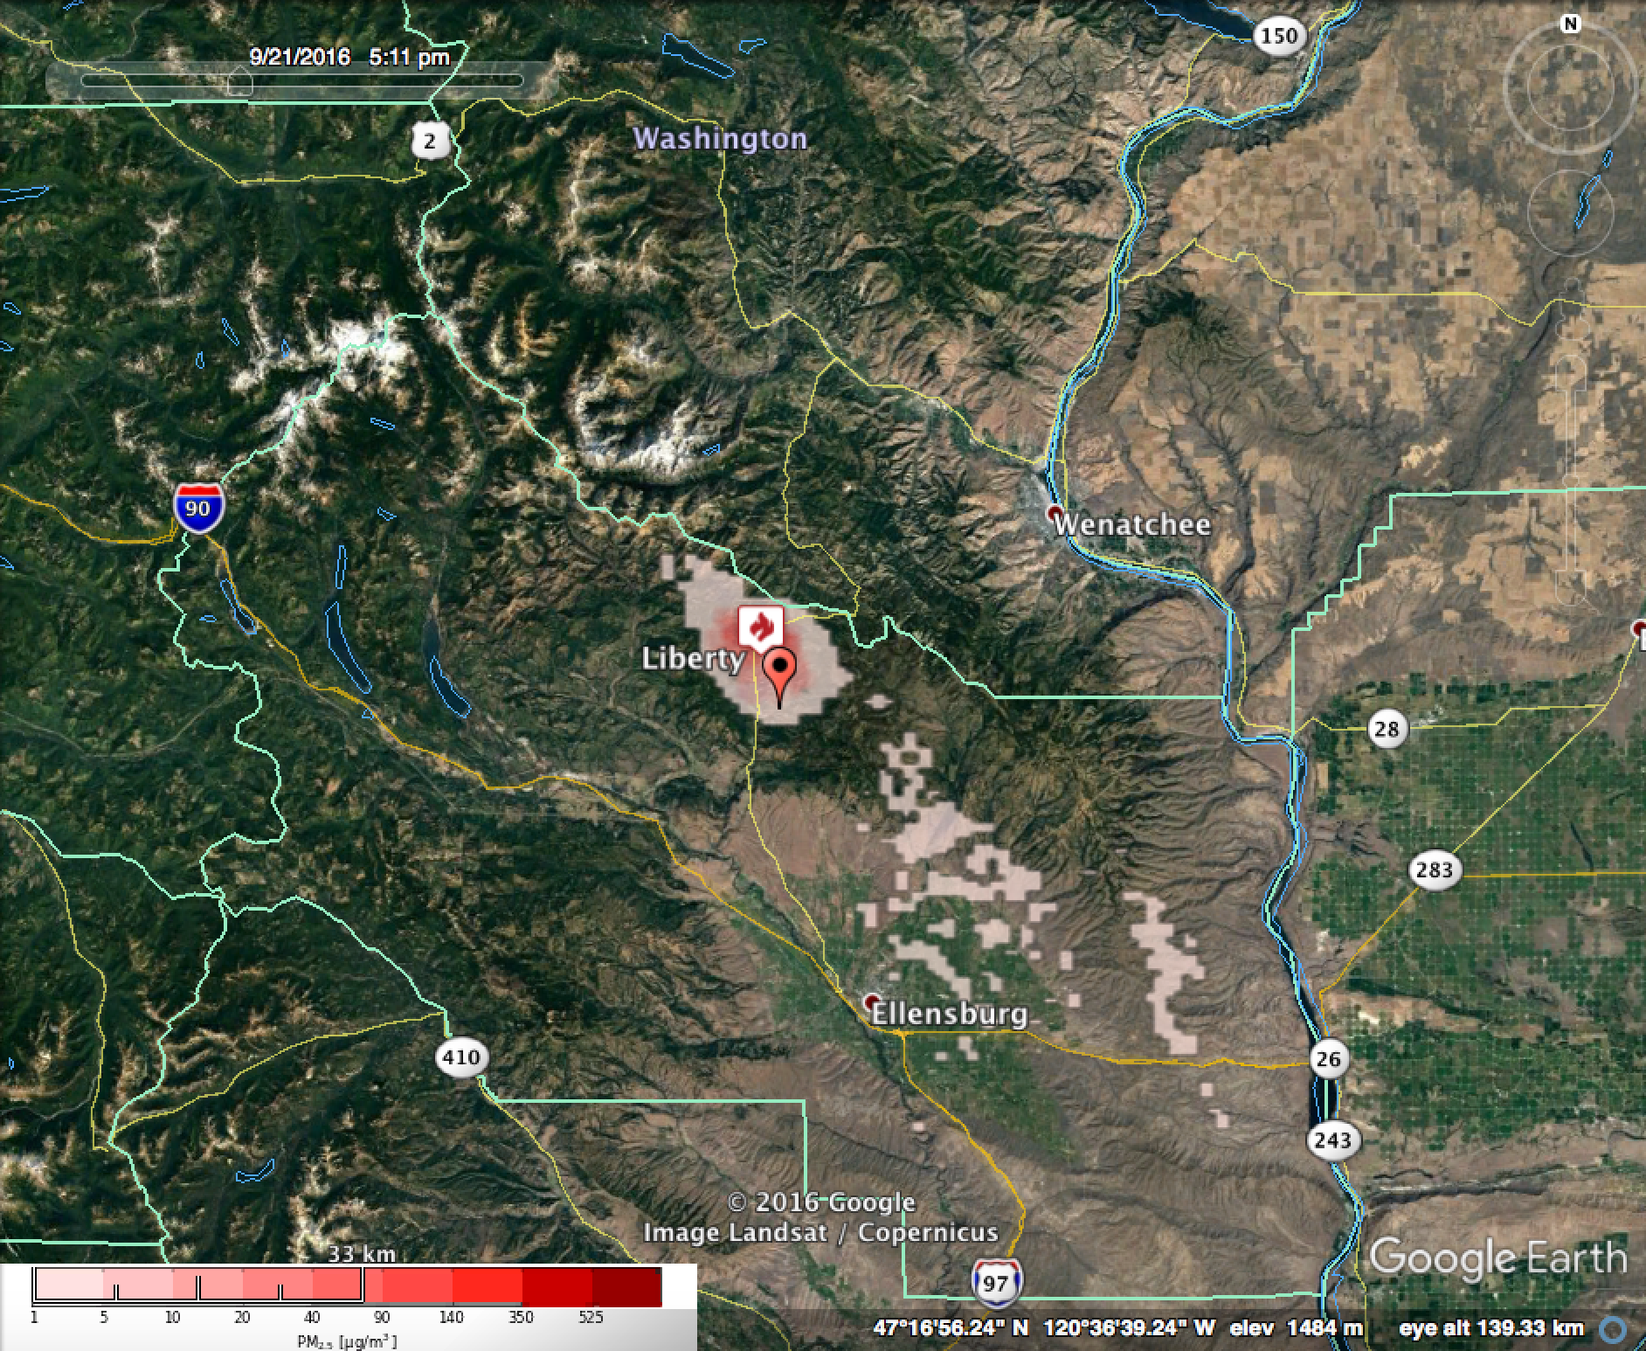
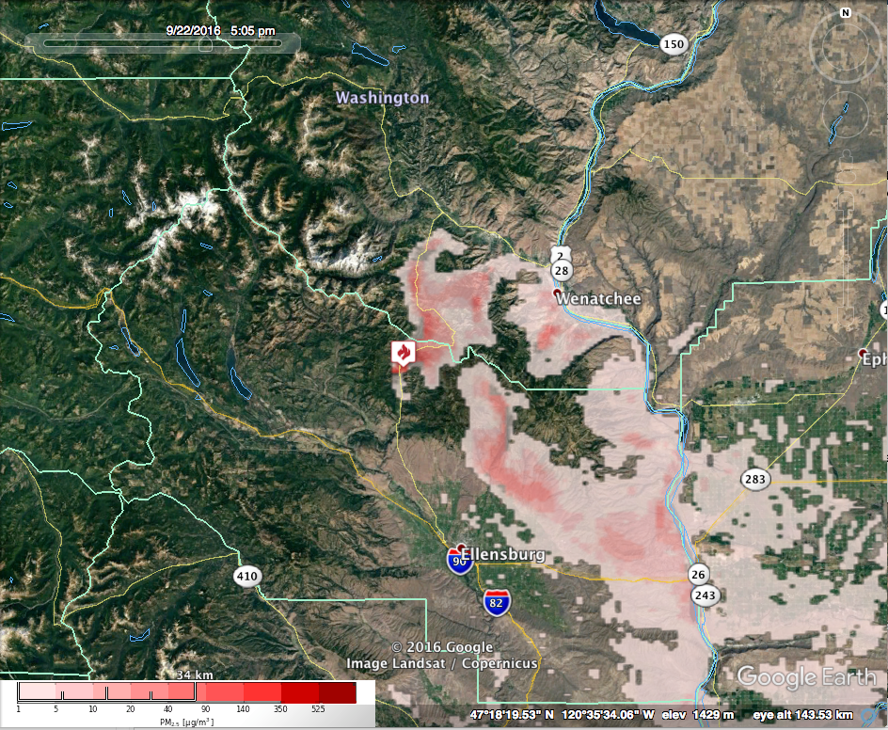
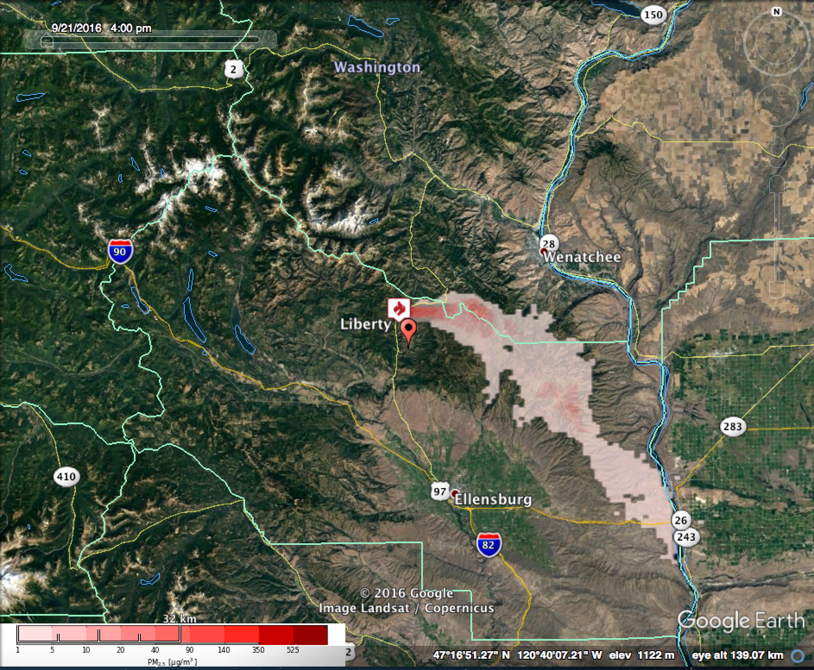
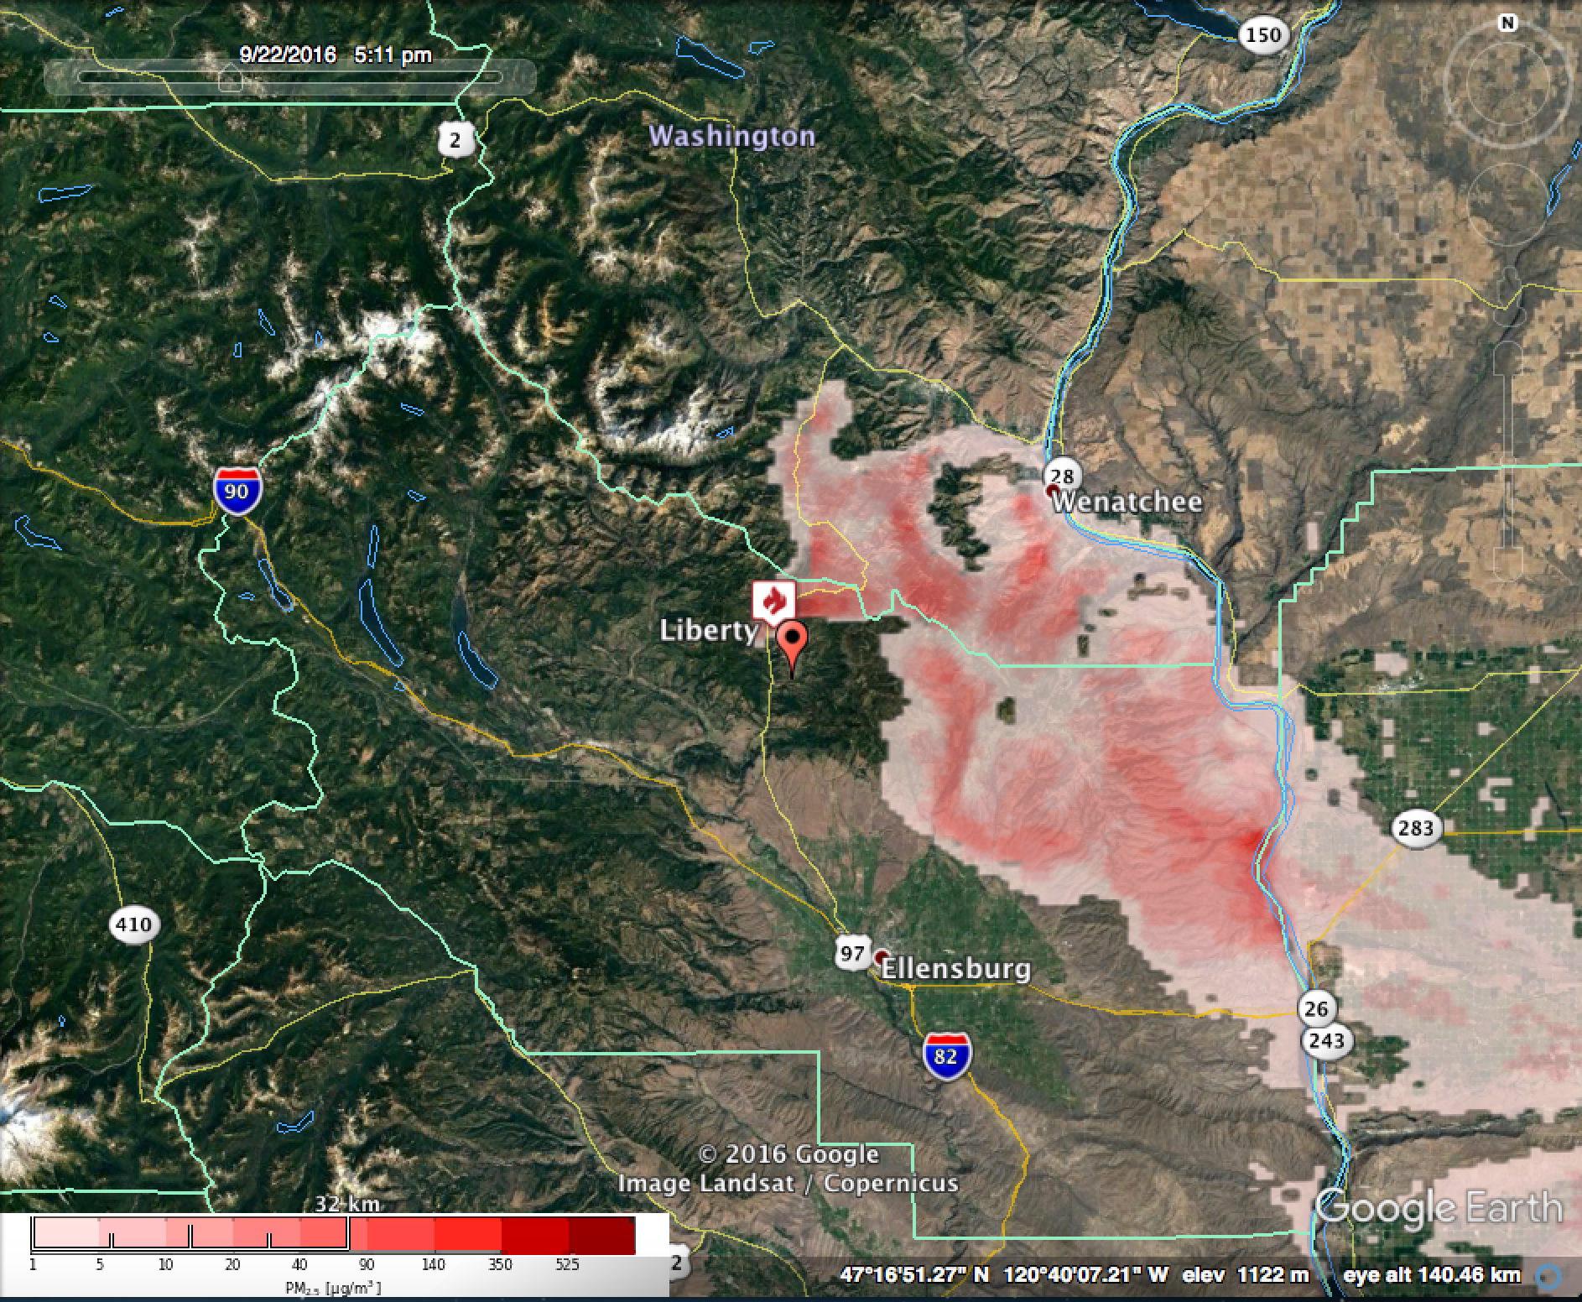
Maximum PM_{2.5} 24-48 hour forecast
00Z 9/22 00Z - 00Z 9/23 00Z (2ndDay)
Initialization: 9/21 00Z
Maximum PM_{2.5} 48-72 hour forecast
00Z 9/23 00Z - 00Z 9/24 00Z (2ndDay)
Initialization: 9/21 00Z
Top Row: BSF initialization 9/21 00Z; Burn ignited 2nd day (11AM PDT 22 Sept)
Maximum PM_{2.5} 12-24 hour forecast
00Z 9/22 - 00Z 9/23
Initialization: 9/22 00Z
Maximum PM_{2.5} 24-48 hour forecast
00Z 9/23 – 00Z 9/24
Initialization: 9/22 00Z
Bottom Row: BSF initialization 9/22 00Z; Burn ignited 1st day (11AM PDT 22 Sept)
Notes:
Daily maximum pm2.5 BlueSky predictions for day 2, and day 3, initialized on 00Z 9/21/2016 (top row) and day 1 and day2, initialized on 00Z 9/22/2016 (bottom row). The fire ignition time is the same for both runs (9/21 11PDT). For the top row, the fire was ignited on the 2nd day of the model run; for the bottom row, the fire was ignited on the 1st day of the run.

Slide 4
Notes:
Time series of PM2.5 at Liberty monitor. Red lines indicate ignition times. Note different scales on the y-axis.

